Slide 1
BRANCH and BRADFORD FAMILIES of HALIFAX COUNTY
NORTH CAROLINA
HALIFAX TOWN
and
ENFIELD OLD COURTHOUSE

Slide 2
Presented by Jeff E. Dickens to the Bradford-Branch Family Gathering at St. John’s Episcopal Church, Tallahassee, Florida, March 24, 2012. This presentation begins with the families of Colonel John Branch and Colonel John Bradford in colonial Halifax County, North Carolina, and follows the historical events and people of Halifax and Enfield through the death of Governor John Branch in Enfield in the year 1863.

Slide 3
“He who steals my purse steals trash,
‘Tis his, ‘twas mine, it has been slave to thousands, But he who filches from me my good name, Takes that which not enriches him, yet leaves me poor indeed.”
Favorite quote of Governor John Branch

Slide 4
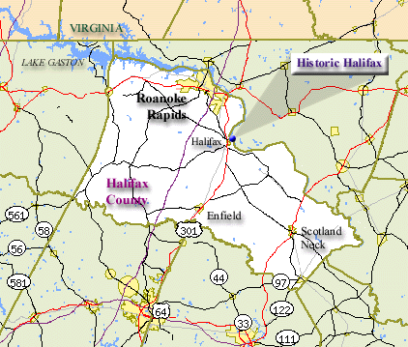
Halifax County

Slide 5
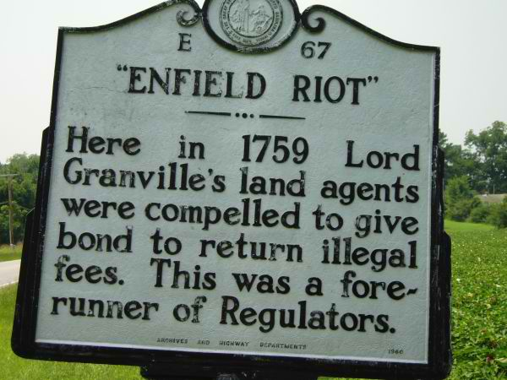
Enfield Riot

Slide 6
Enfield had been the county seat of Edgecombe County prior to the formation of Halifax County in 1754. On the Enfield Tract was located the British Courthouse that served the Granville area. Located nearby were a jail, tavern, silversmith, blacksmith, and other businesses in the small village of Enfield. Lord Granville’s land office was also located in Enfield. It was in this building that Francis Corbin was held until he gave bond to return the illegally collected fees. Col. John Branch would later own this “Enfield Tract” of land. Col. John Bradford lived just a short distance from “Enfield Old Courthouse.”

Slide 7
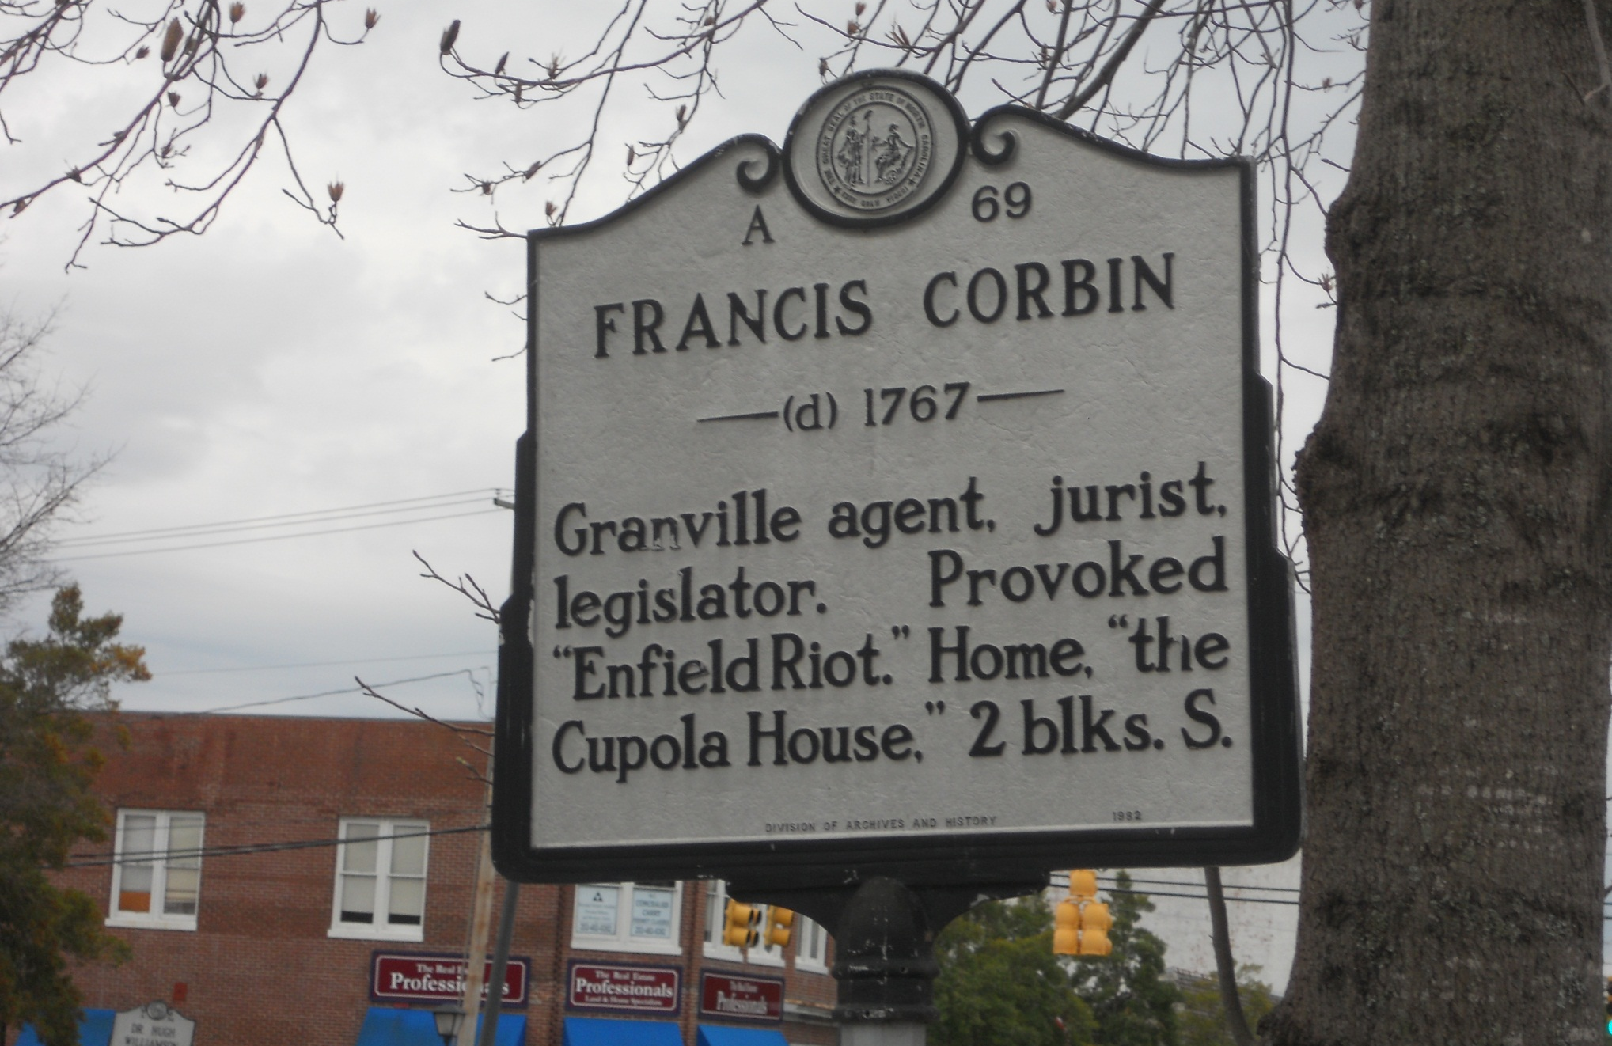
Edenton, North Carolina
Lord Granville had been one of the eight Lord Proprietors.
He had retained ownership of the northern area of the Providence of North Carolina.

Slide 8
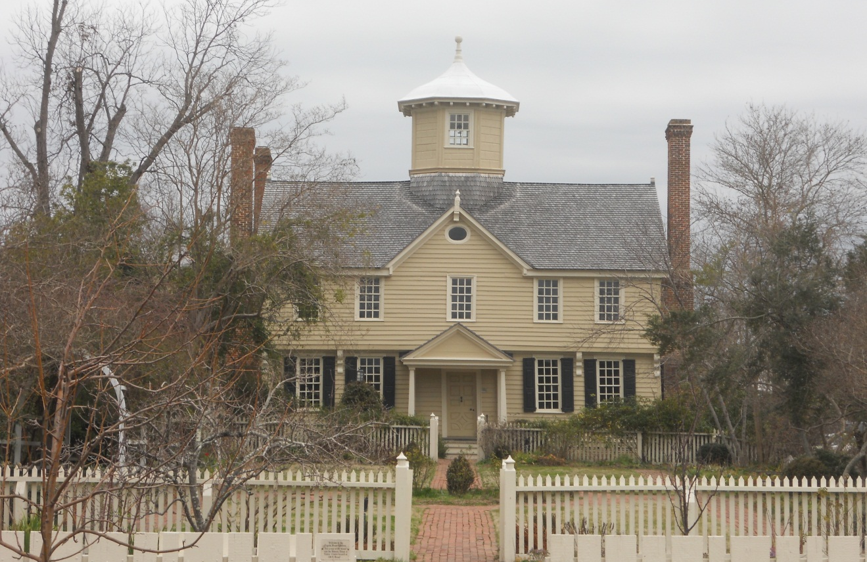
Cupola House Edenton , North Carolina
Home of Francis Corbin, who provoked “Enfield Riot.”
Built 1758

Slide 9
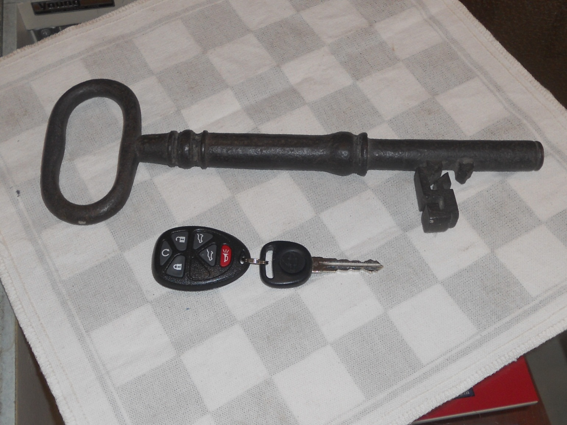
Thought to be the key to the British court house at Enfield.

Slide 10
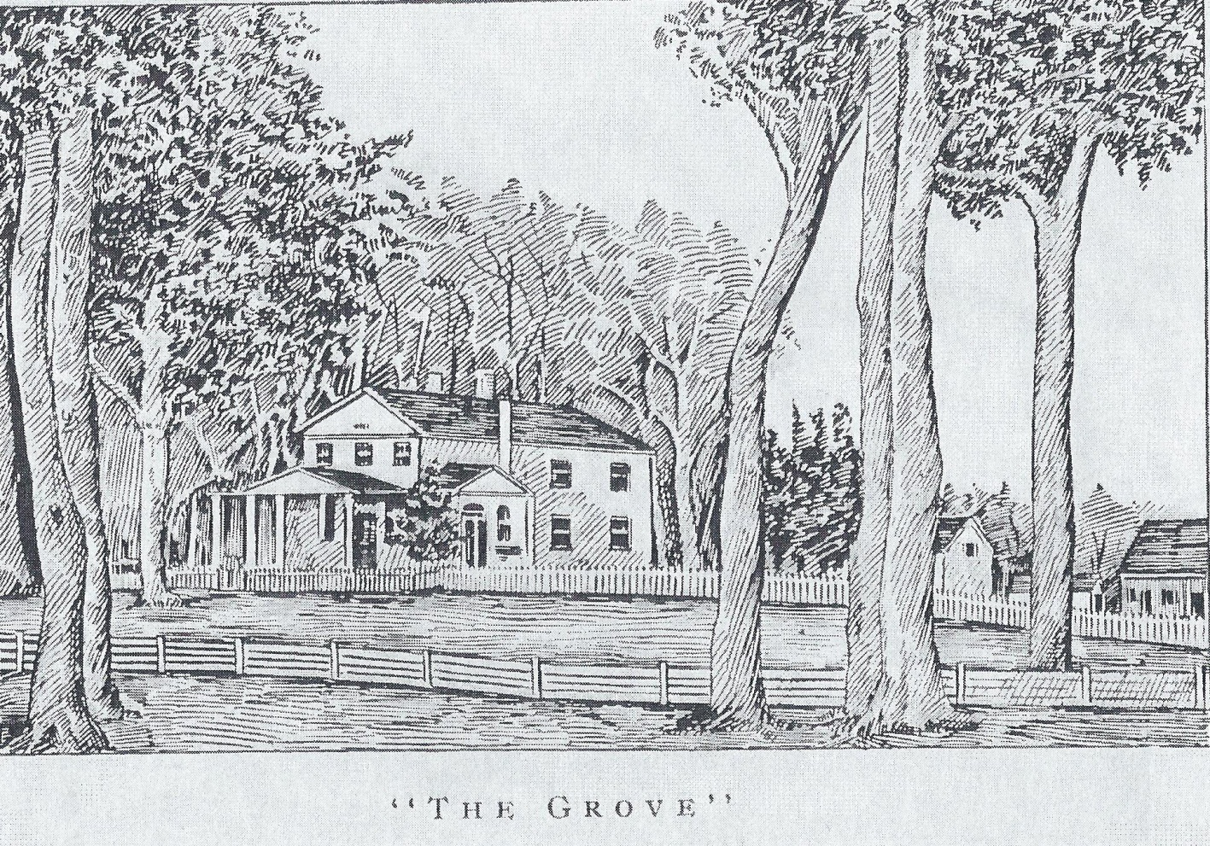
“The Grove” home of Willie Jones
Jones was an anti-federalist who said he would greet George Washington as a gentleman and soldier but not as a president. Lafayette visited the widow Jones here in 1825. Local history says that John Paul Jones took the last name “Jones” from the Jones family of Halifax.

Slide 11
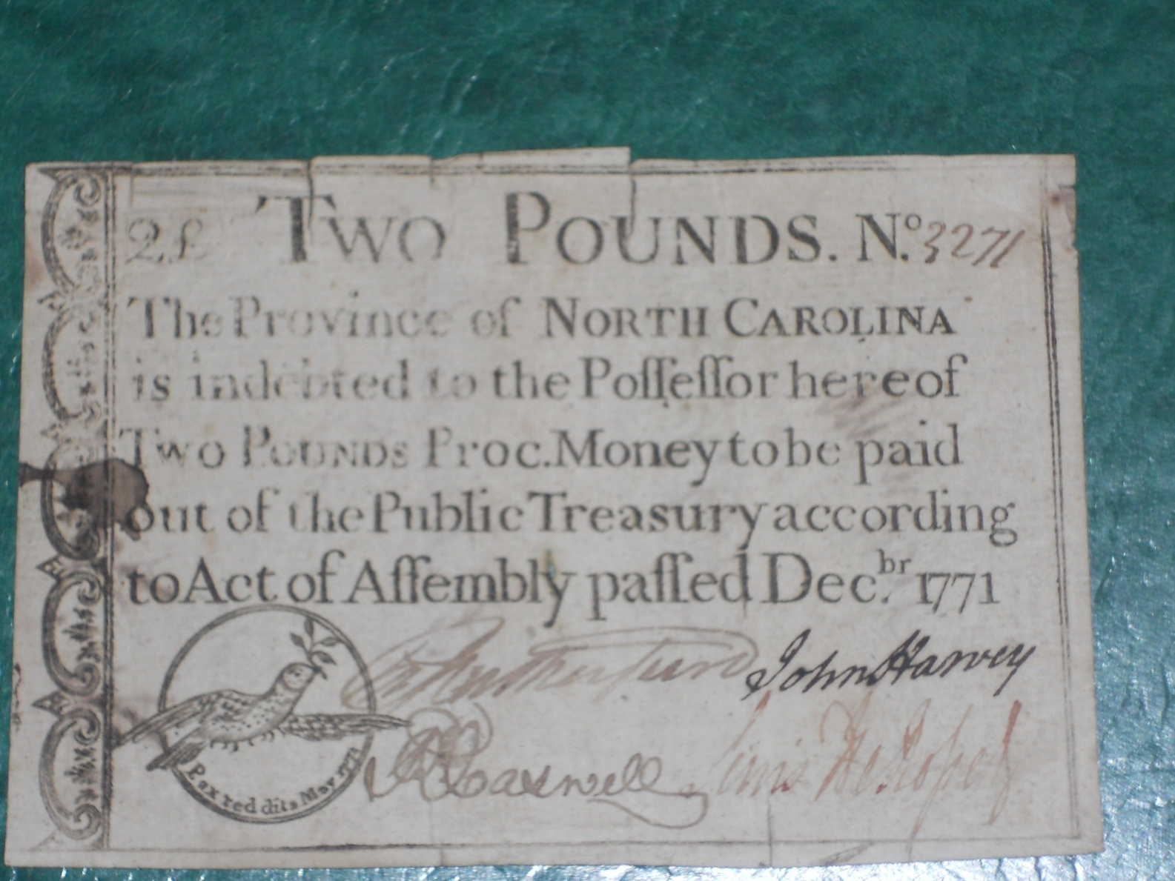
Two Pound North Carolina Note
Signed on the front by Richard Caswell and on the back by Joseph Montfort.

Slide 12
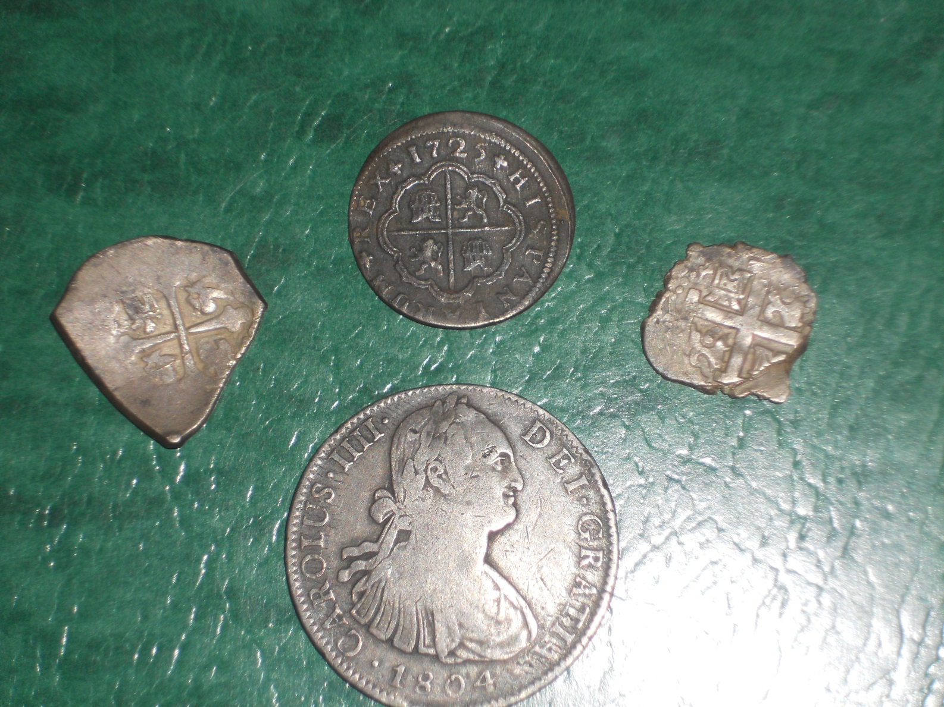
Spanish silver coinage from the Enfield area
Spanish silver coins from Mexico and Peru found their way into the colonies.
This was legal tender into the 1850s.

Slide 13
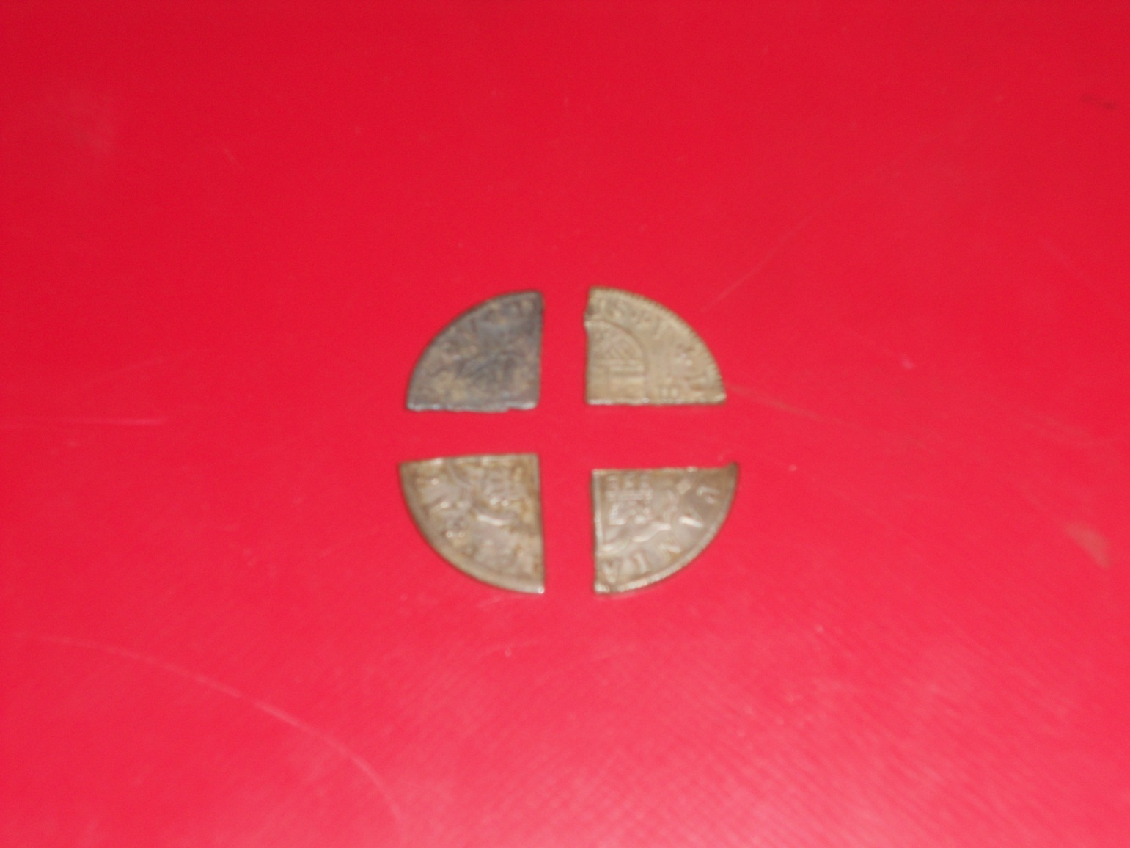
Silver coins were cut during the colonial era to make change.
These come from the Enfield area.

Slide 14
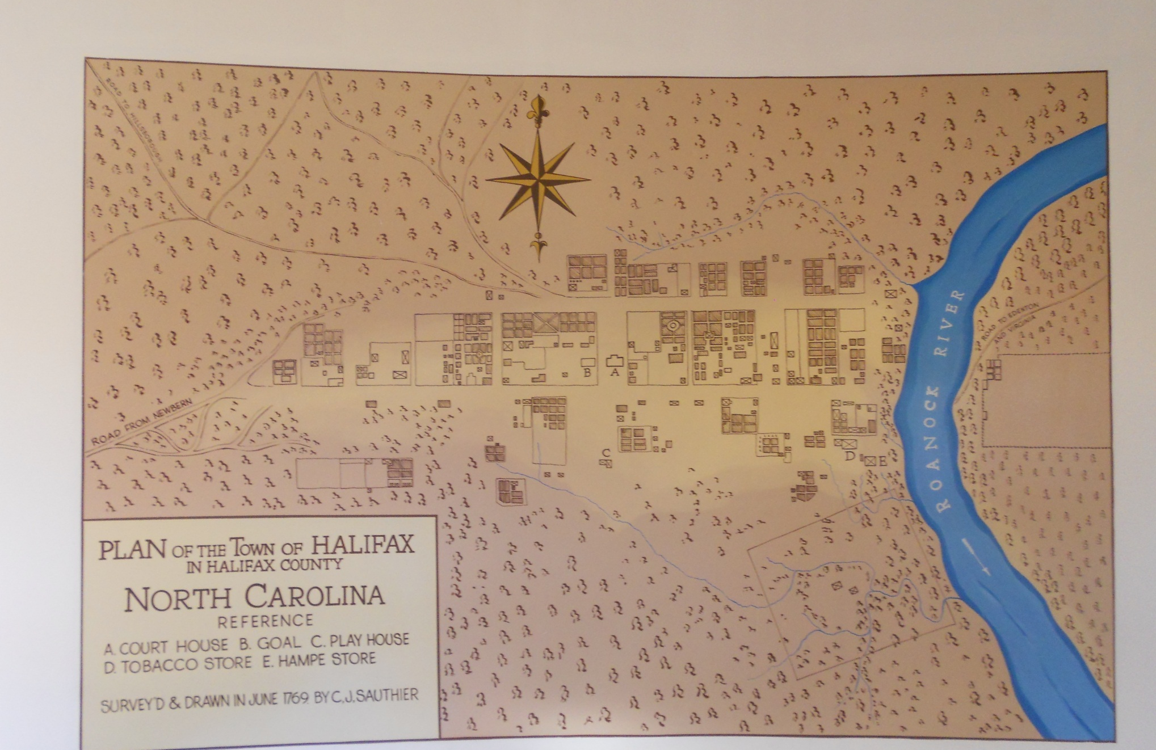
Halifax Town
Sauthier Map of Halifax 1769

Slide 15
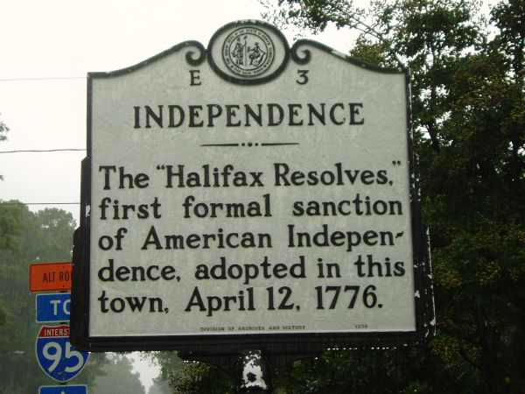
North Carolina led the way in seeking independence from Great Britain.

Slide 16
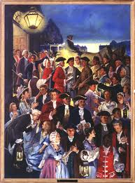
The citizens of Halifax greet the delegates as they emerge from the courthouse minutes after they have all stood together on
April 12, 1776, in adopting what would become known as the
HALIFAX RESOLVES.
North Carolina’s delegates to the Fourth Provincial Congress have just instructed their delegates to vote for independence in Philadelphia.
Colonel John Bradford was among those who stood for independence from Great Britain, he being one of the delegates from Halifax County.

Slide 17

North Carolina flag with the date of the Halifax Resolves

Slide 18
Col. John Bradford served in many ways during the Revolution. From 1766-1768 he represented Halifax in the Colonial Assembly. In 1774 he was a member of the Committee of Safety. In 1775 he was made colonel of the Halifax Militia. In 1775 he was a member of the 3rd Provincial Congress and in 1776 he was a member of the 4th Provincial Congress, representing Halifax County. In 1777 he was the first senator to represent Halifax in the General Assembly. In battles during 1778 and after the war, he was Presiding Justice of the Court of Common Pleas.

Slide 19
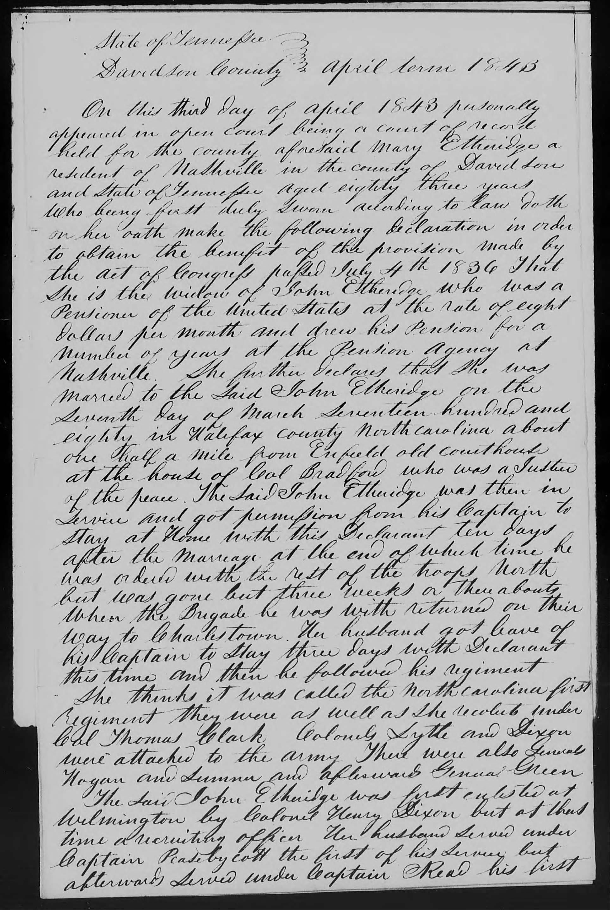
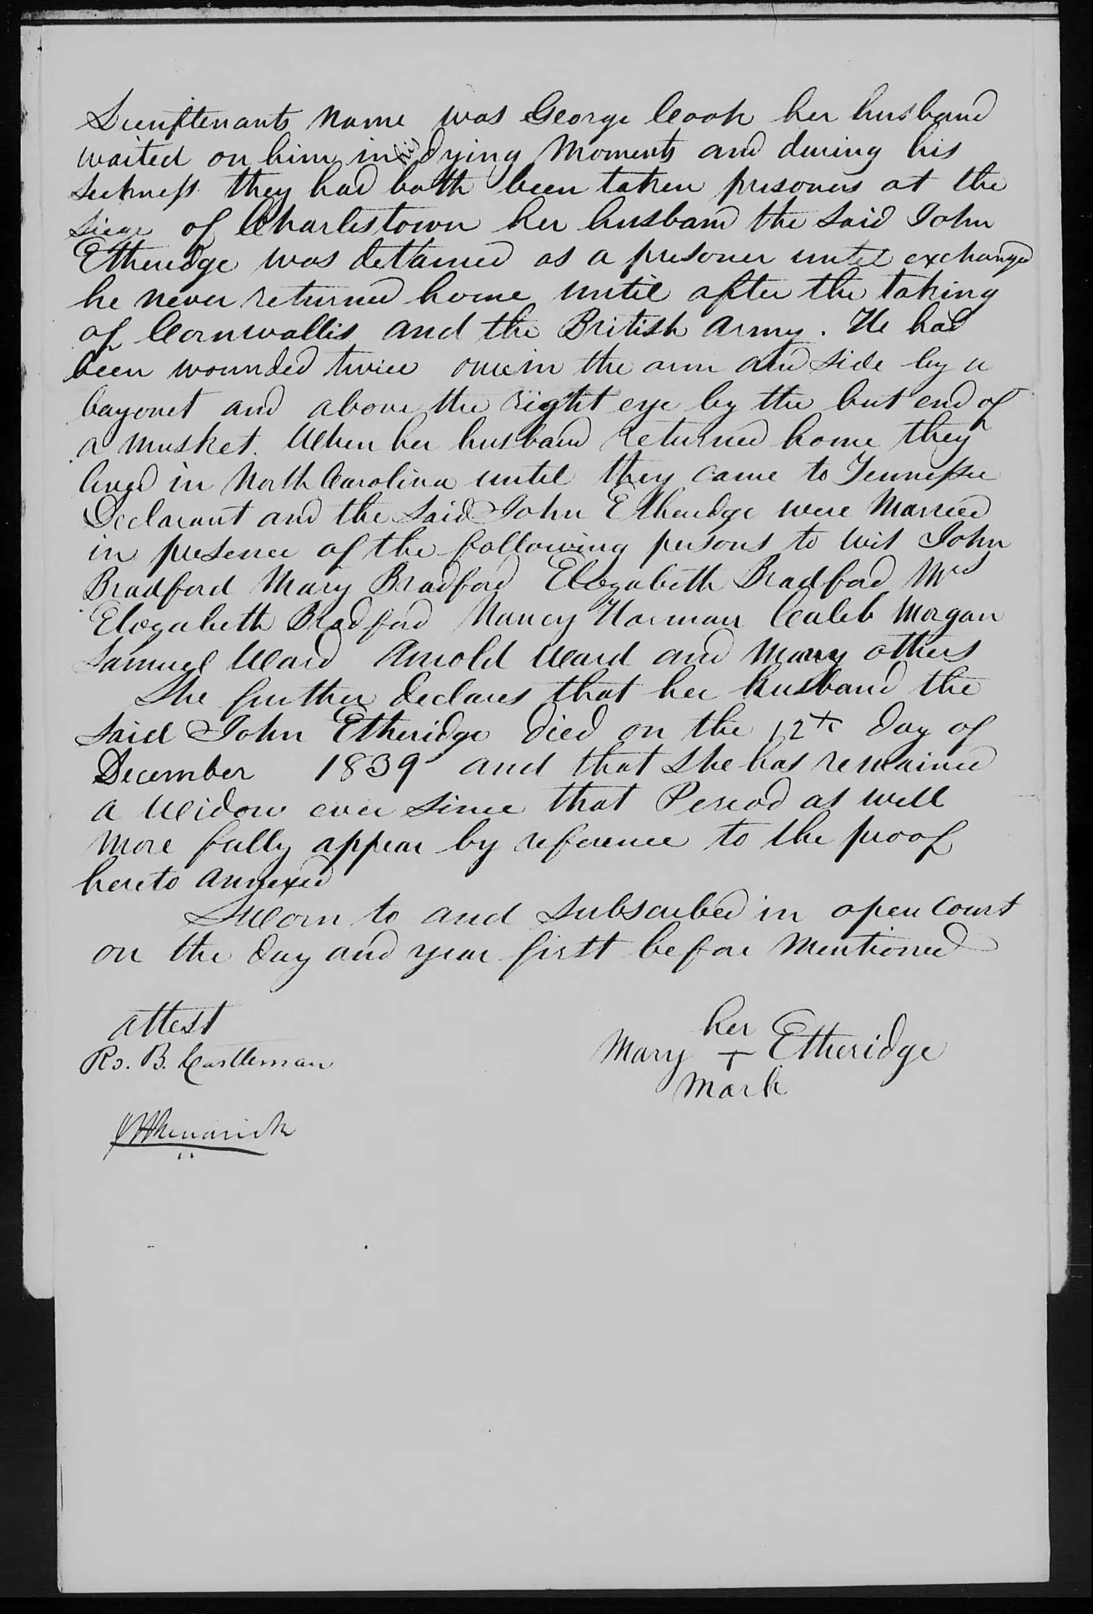
In 1843 Mary Etheridge stated in her application for a pension that she married John Etheridge one half mile from Enfield Old Courthouse in the home of Col. John Bradford. Witnesses were John, Mary, and Elizabeth Bradford.
March 7, 1780.

Slide 20
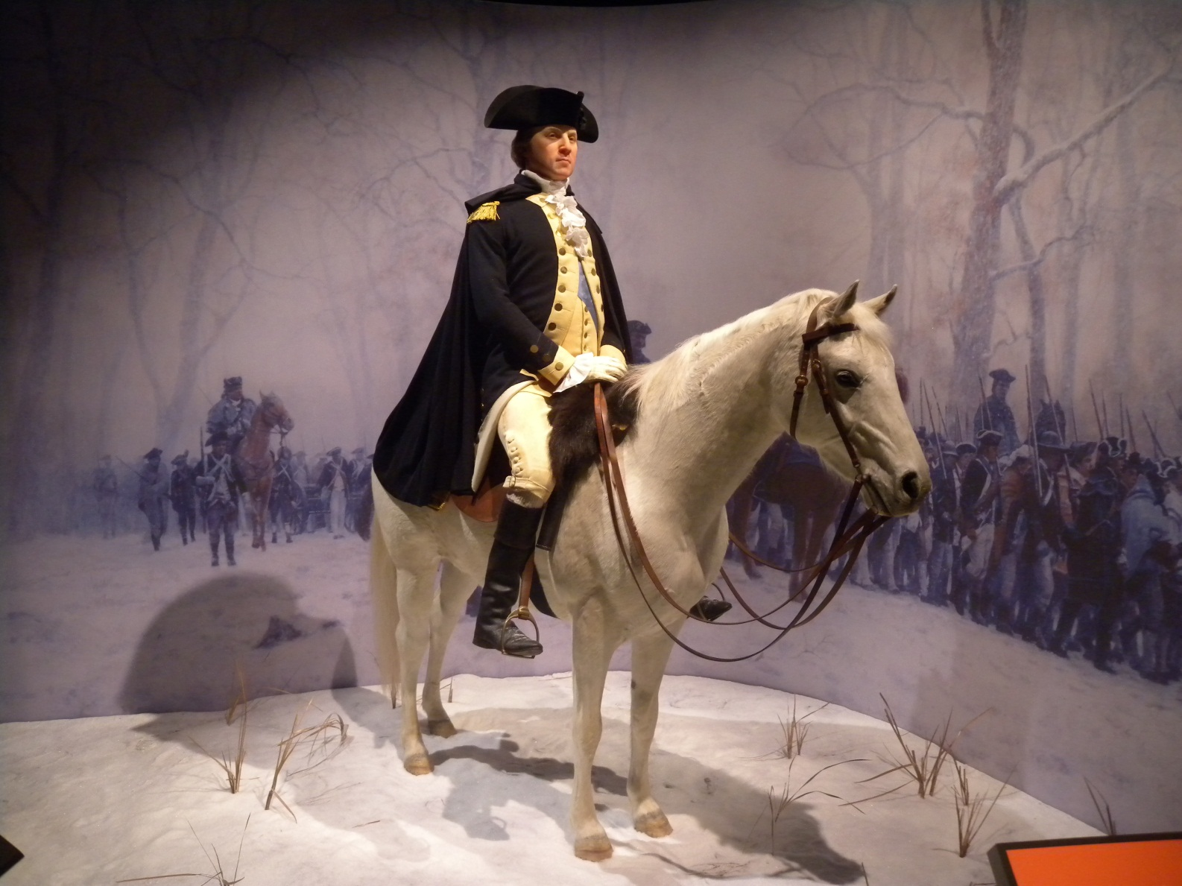
General Washington at Valley Forge
Washington’s printer at Valley Forge was Abraham Hodge.
Hodge moved to Halifax, opened a printing shop there, and is buried
in the Old Colonial Cemetery in Historic Halifax.

Slide 21
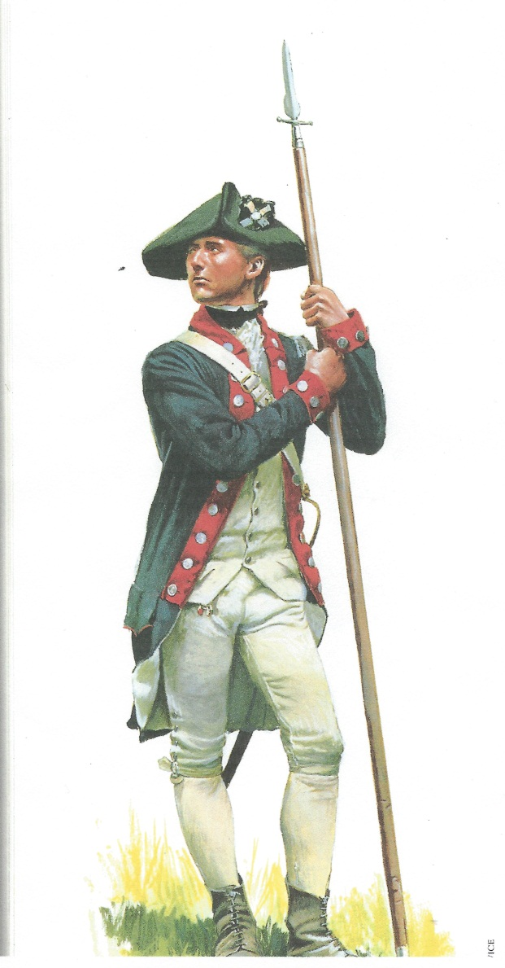
Uniform of North Carolina Continental Line Soldier
Halifax was the commissary for North Carolina Troops in the Revolutionary War.

Slide 22
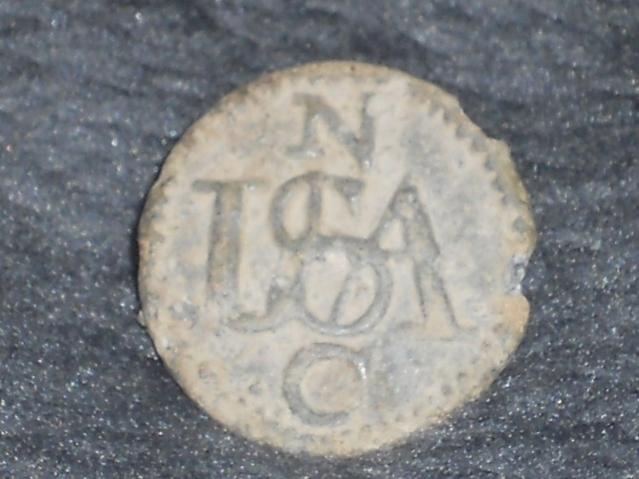
North Carolina Continental Army Button
USA NC buttons were only made in Halifax at Col. Nicholas Long’s “Public Works.”
This button was found outside Halifax in a cotton field that had served as a camp site.

Slide 23
William Wooten’s Sword Cane
William Wooten was the Clerk of Court for Halifax County when Cornwallis and Tarleton entered Halifax. Wooten was Henry Bradford’s brother-in-law,
having married Frances Bradford.

Slide 24
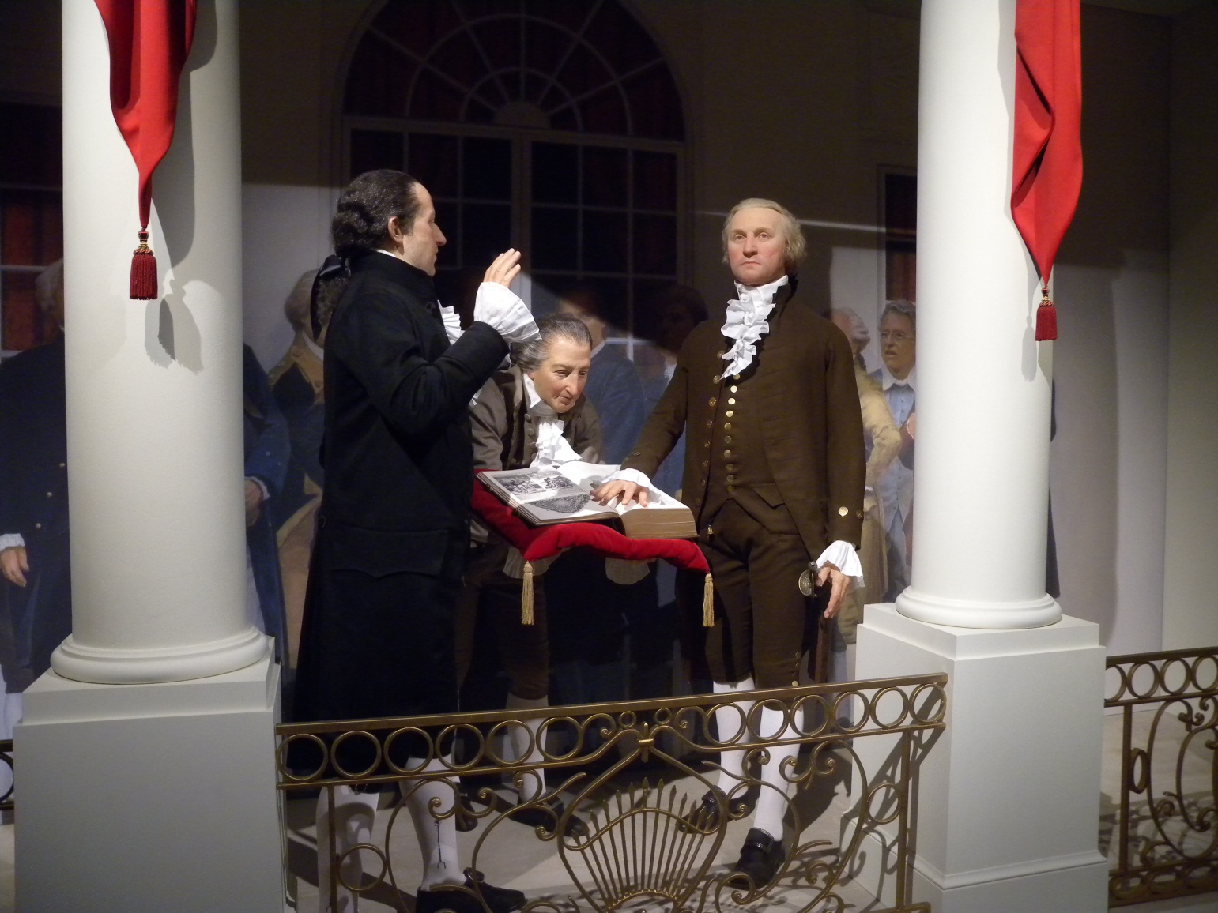
George Washington being sworn in as
President of the United States
Washington spent the night and was entertained in Halifax on his Southern Tour.

Slide 25
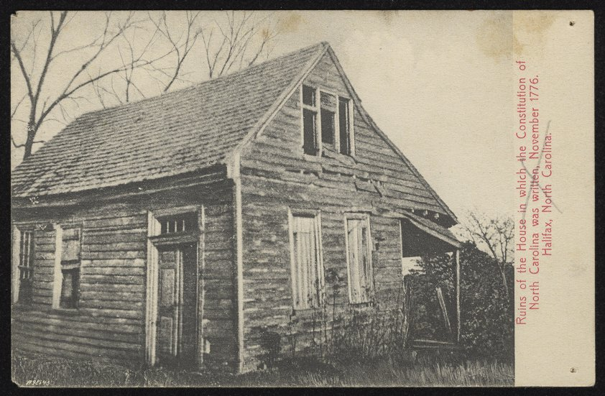
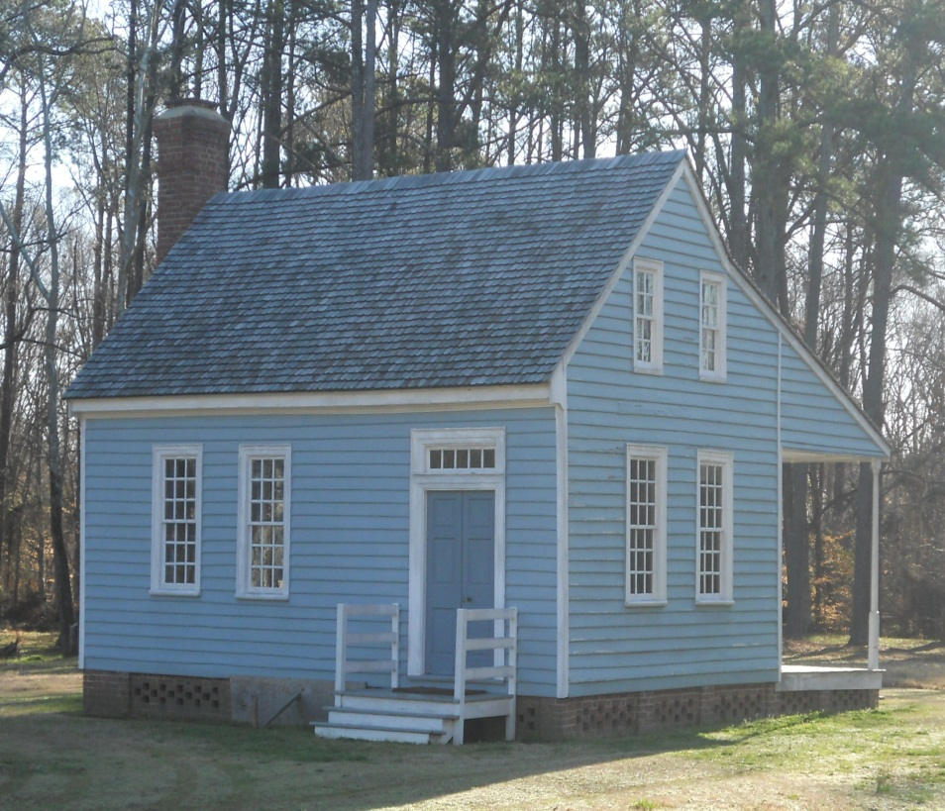
The Burgess House
Before and After Restoration
Historic Halifax

Slide 26
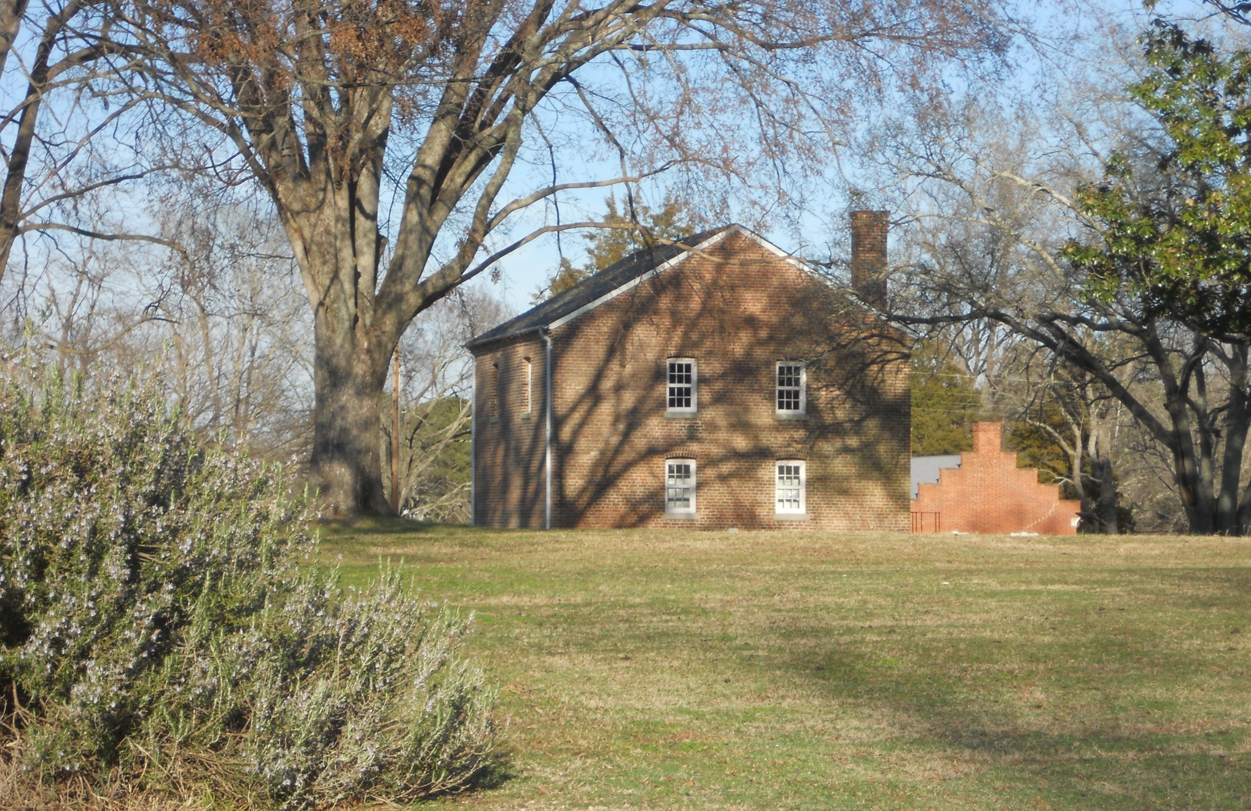
Jail in Historic Halifax
Col. John Bradford and Col. John Branch were sheriffs of Halifax County.
This is the third jail built in Halifax. Inmates trying to escape had burned the first two structures, making the construction of a brick jail necessary.

Slide 27
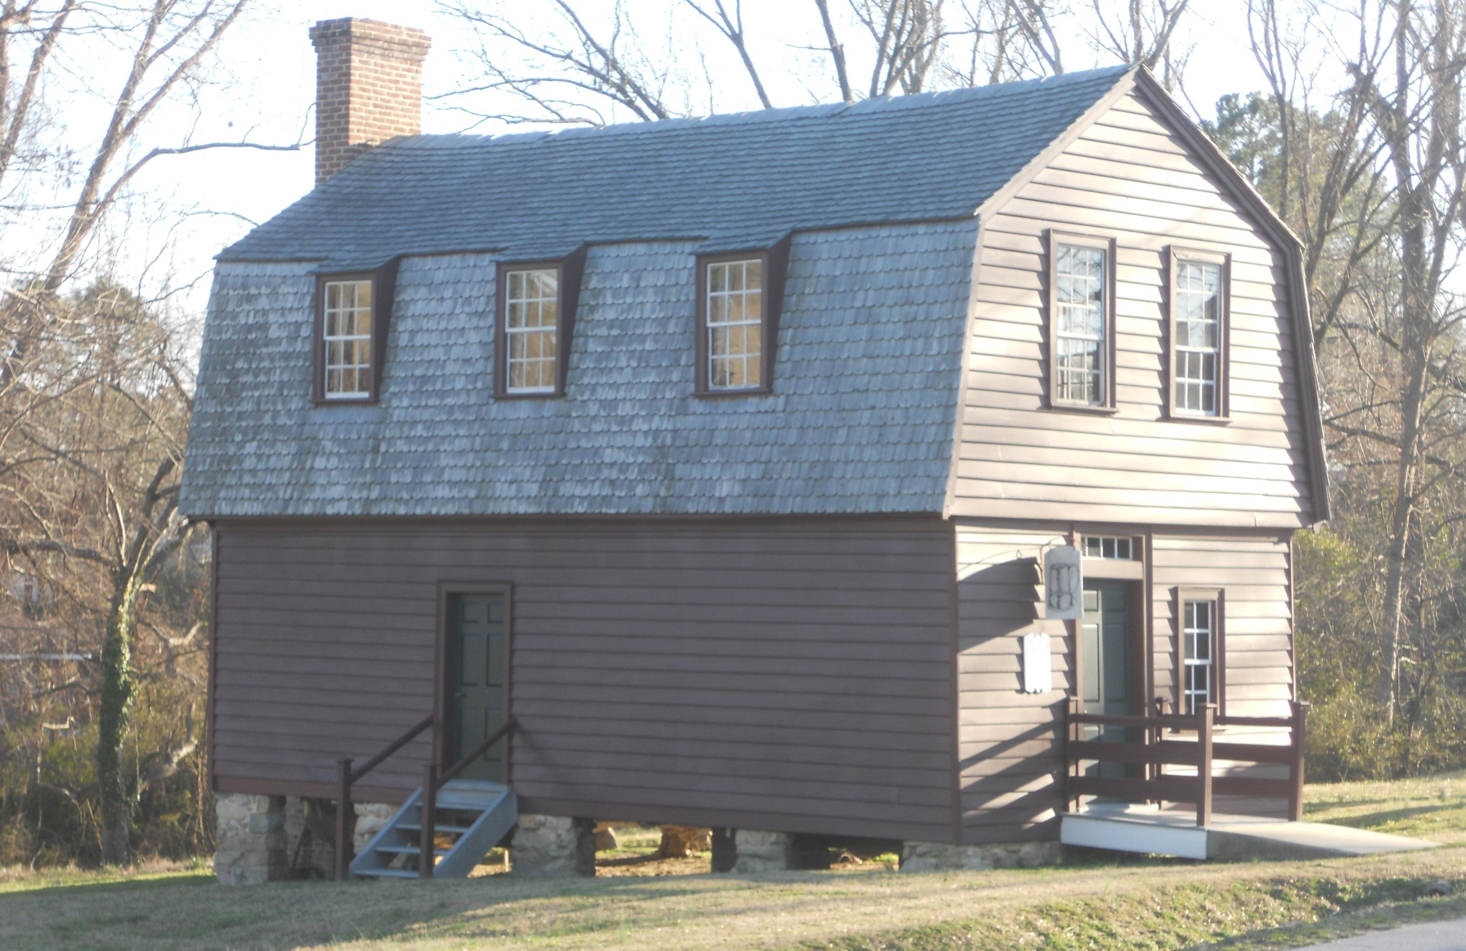
Tap Room in Historic Halifax
Local Tavern

Slide 28
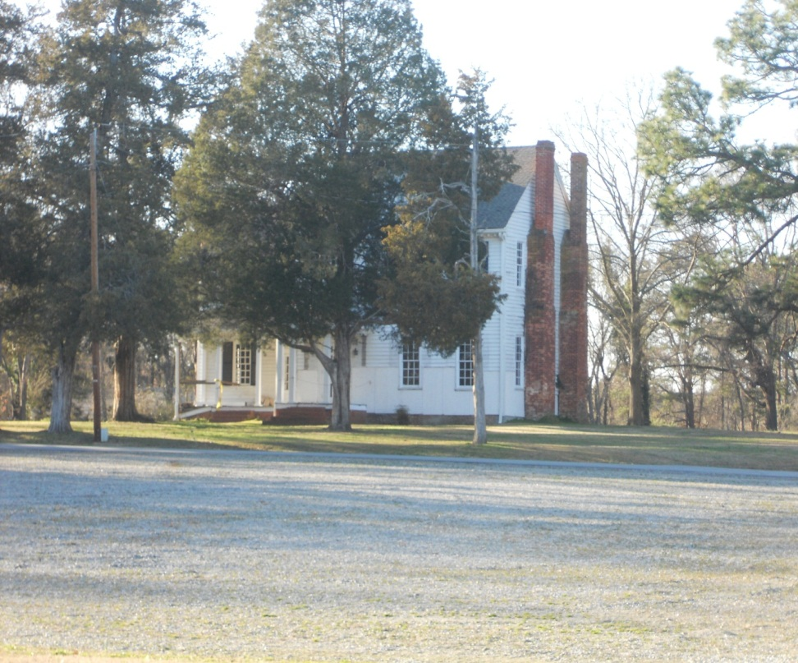
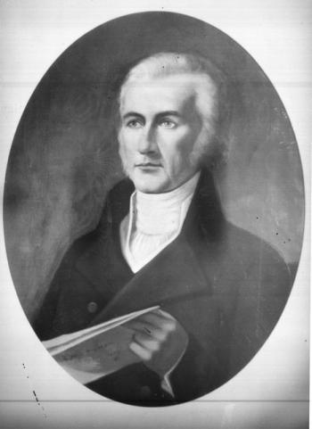
“Loretta,” home of
General William R. Davie
Father of the University of North Carolina
Davie owned the celebrated race horse Sir Archie.
William Richardson Davie

Slide 29
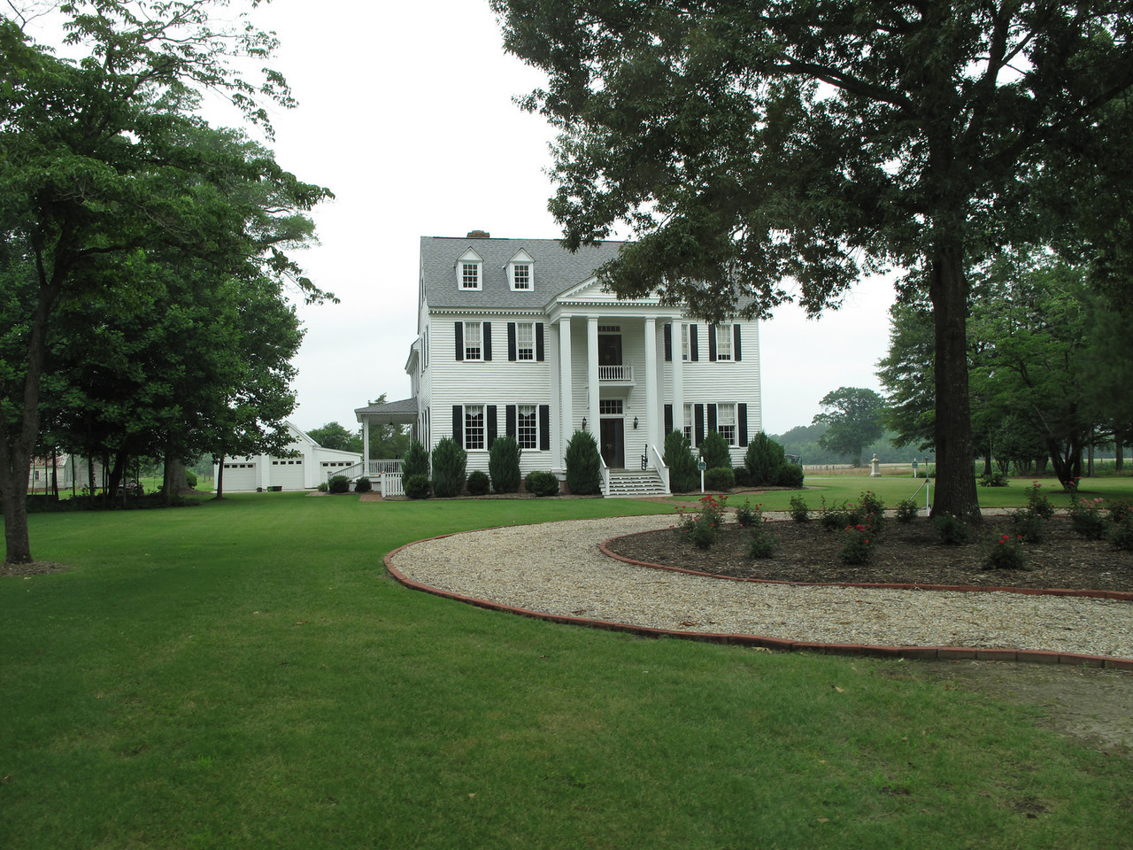
Shell Castle
This home is located on Bradford property that was sold to Matthew Cary Whitaker. Matthew Cary Whitaker had run away from home at 16 to join his uncle, Col. John Whitaker, fighting the British. The mother of Confederate Generals Robert and Matt Ransom was born here.

Slide 30
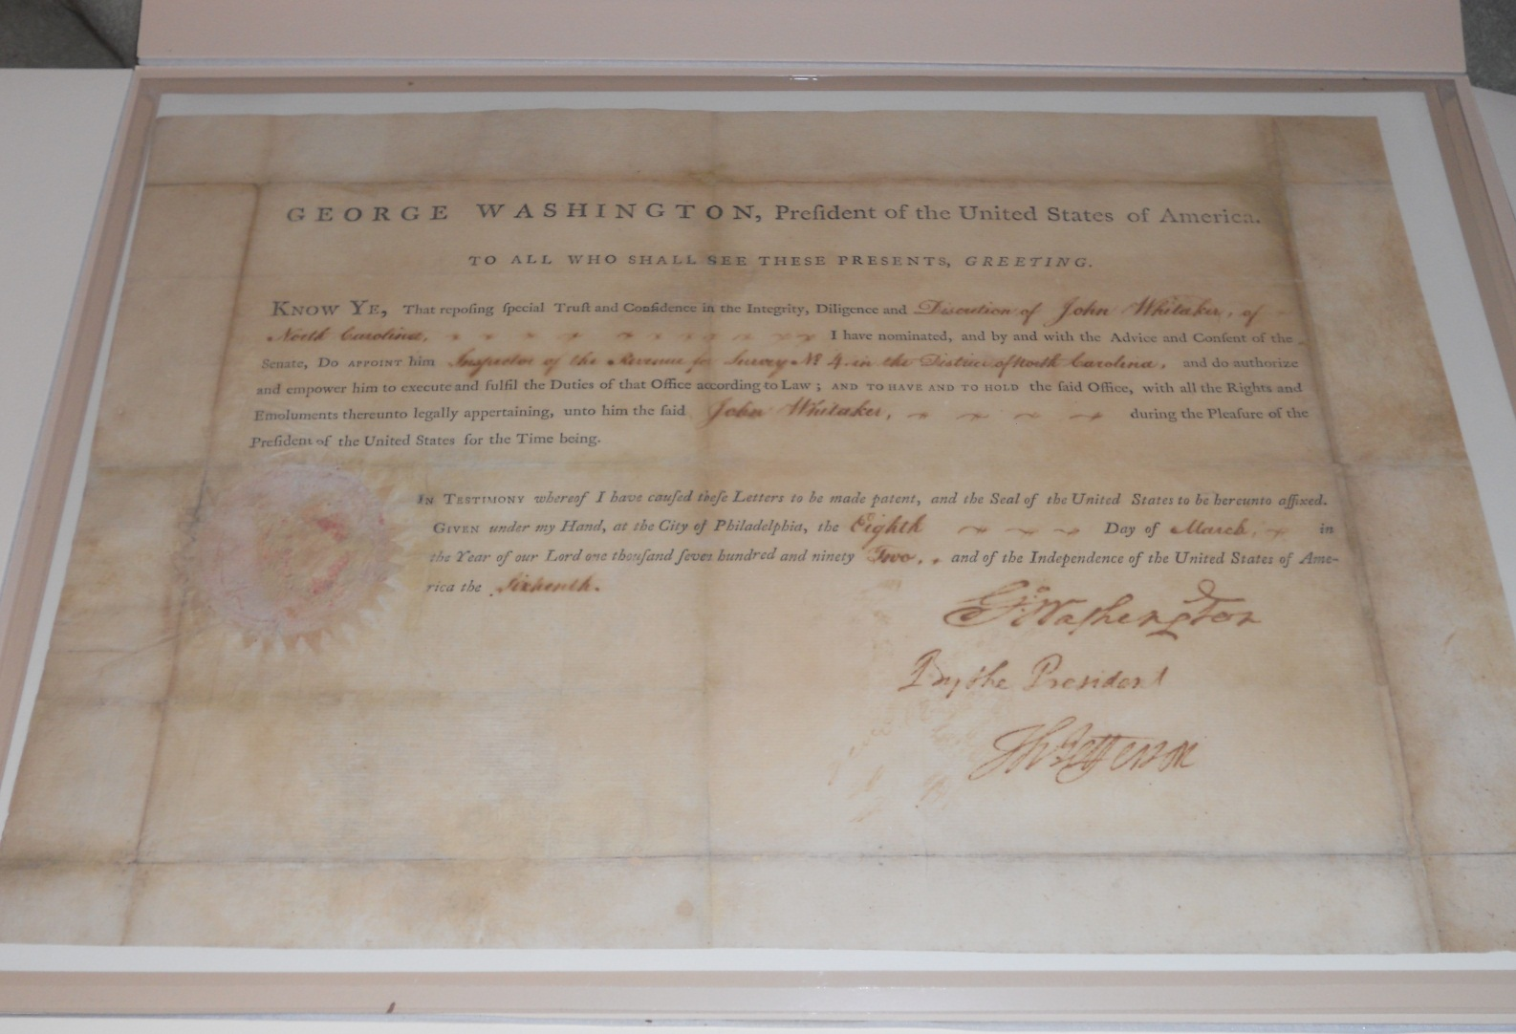
Commission given to Col. John Whitaker to collect taxes on liquor and the stills that made it. Signed by the President,
George Washington, and Secretary of State Thomas Jefferson, it was issued from Philadelphia in 1792.

Slide 31
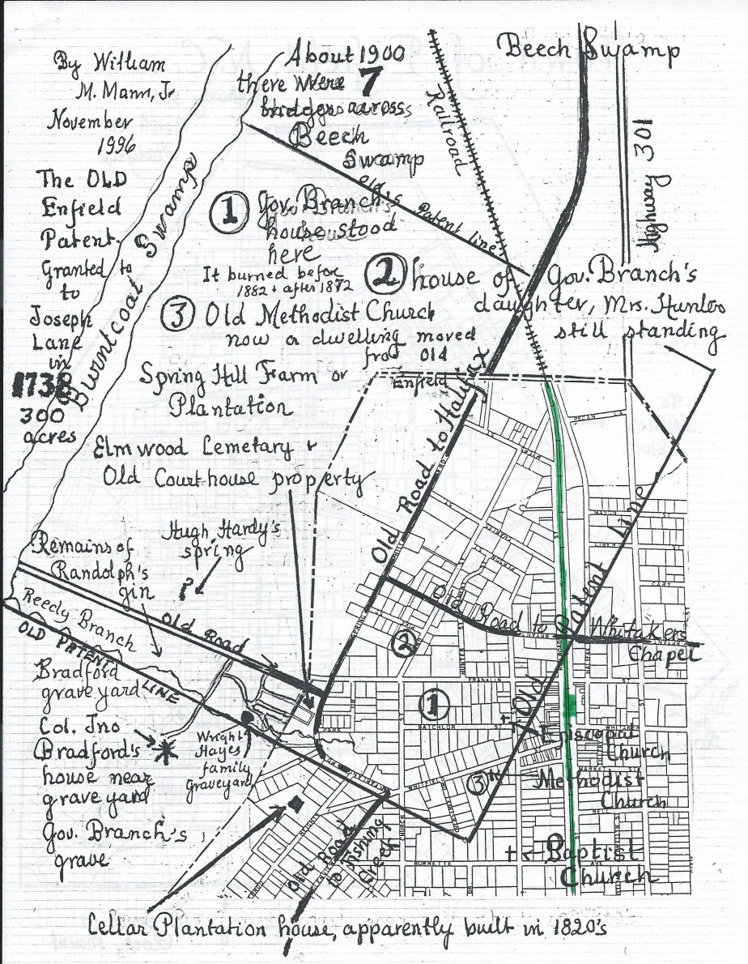
Layout of Modern Enfield with Gov. Branch’s Property
1. Gov. Branch’s house 2. Dr. James and Sarah Branch Hunter’s house

Slide 32
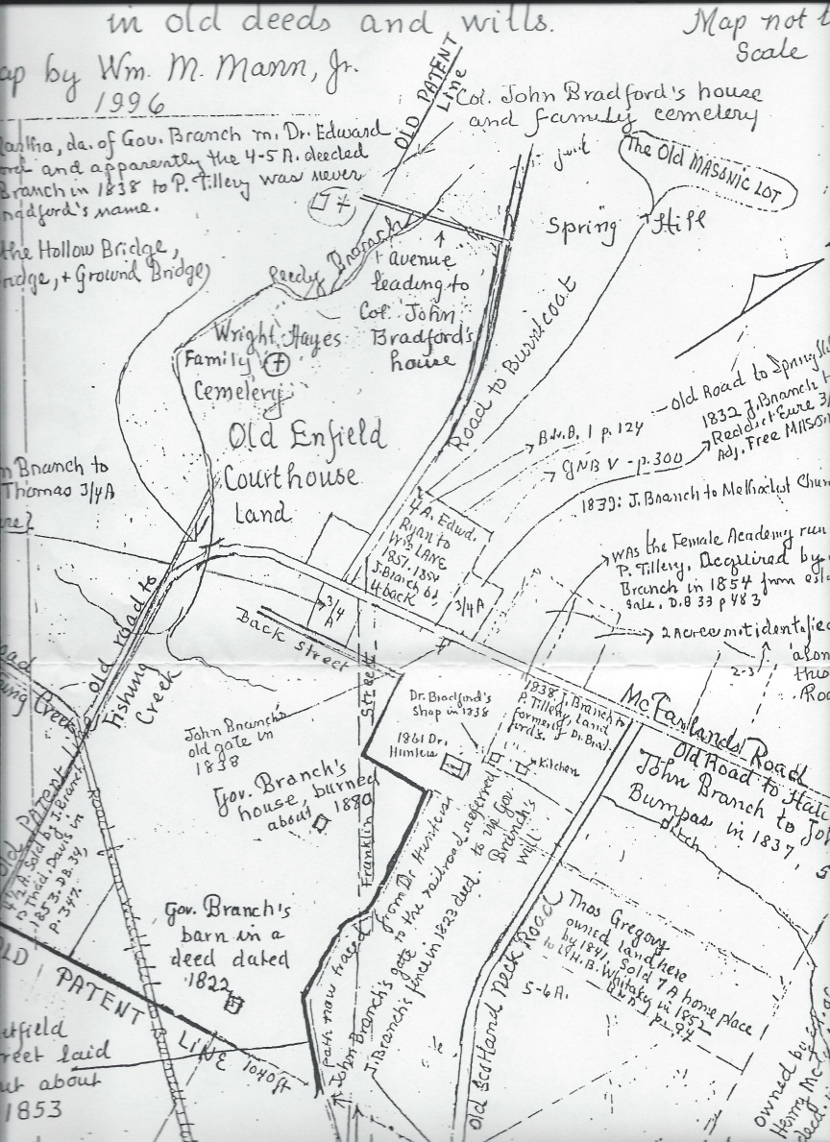
Map of Old Enfield Court House Land
Researched and prepared by Dr. William M. Mann, Jr.

Slide 33
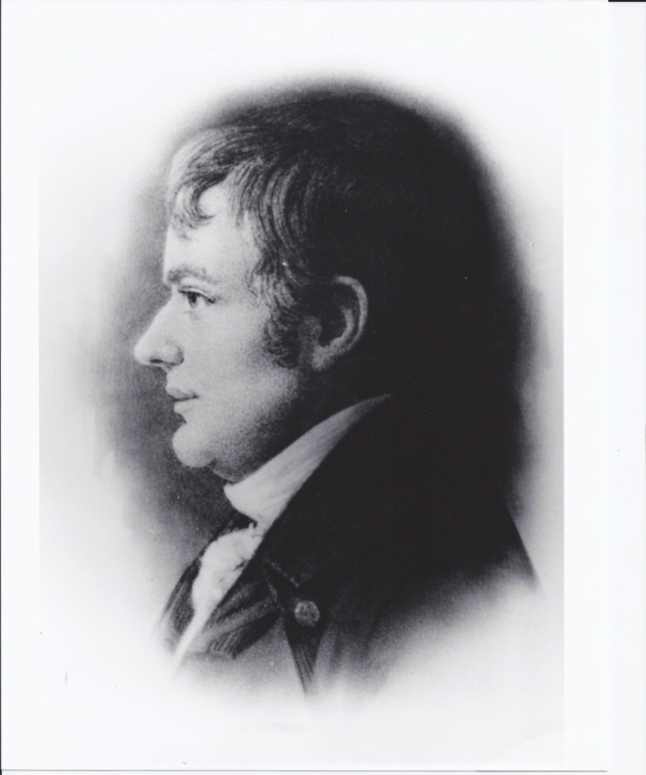
The Reverend Henry Bradford
1761-1833
Son of Col. John Bradford
and Patience Reed
Married Sarah Crowell
Revolutionary War Soldier
Early Methodist Minister
Ordained by Bishop Asbury
Held camp meetings ca. 1800
Founded Bradford’s Chapel
Operated Bradford’s Academy
Composed hymns
Thought to be buried in Bradford Cemetery next to his home

Slide 34
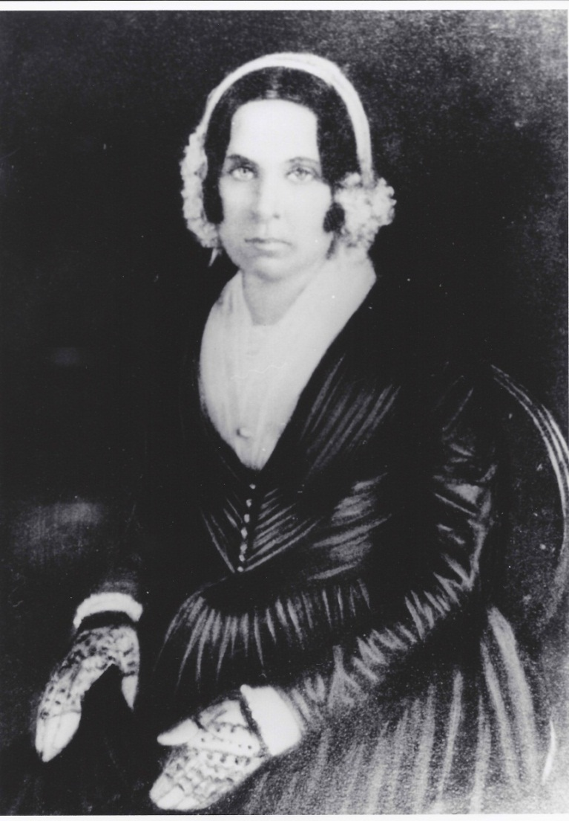
Sarah Crowell Bradford
1763-1839
Member of Crowell Family
Moved to Florida after Henry’s death
Died in Florida 1839
Buried in Pine Hill Plantation Cemetery

Slide 35
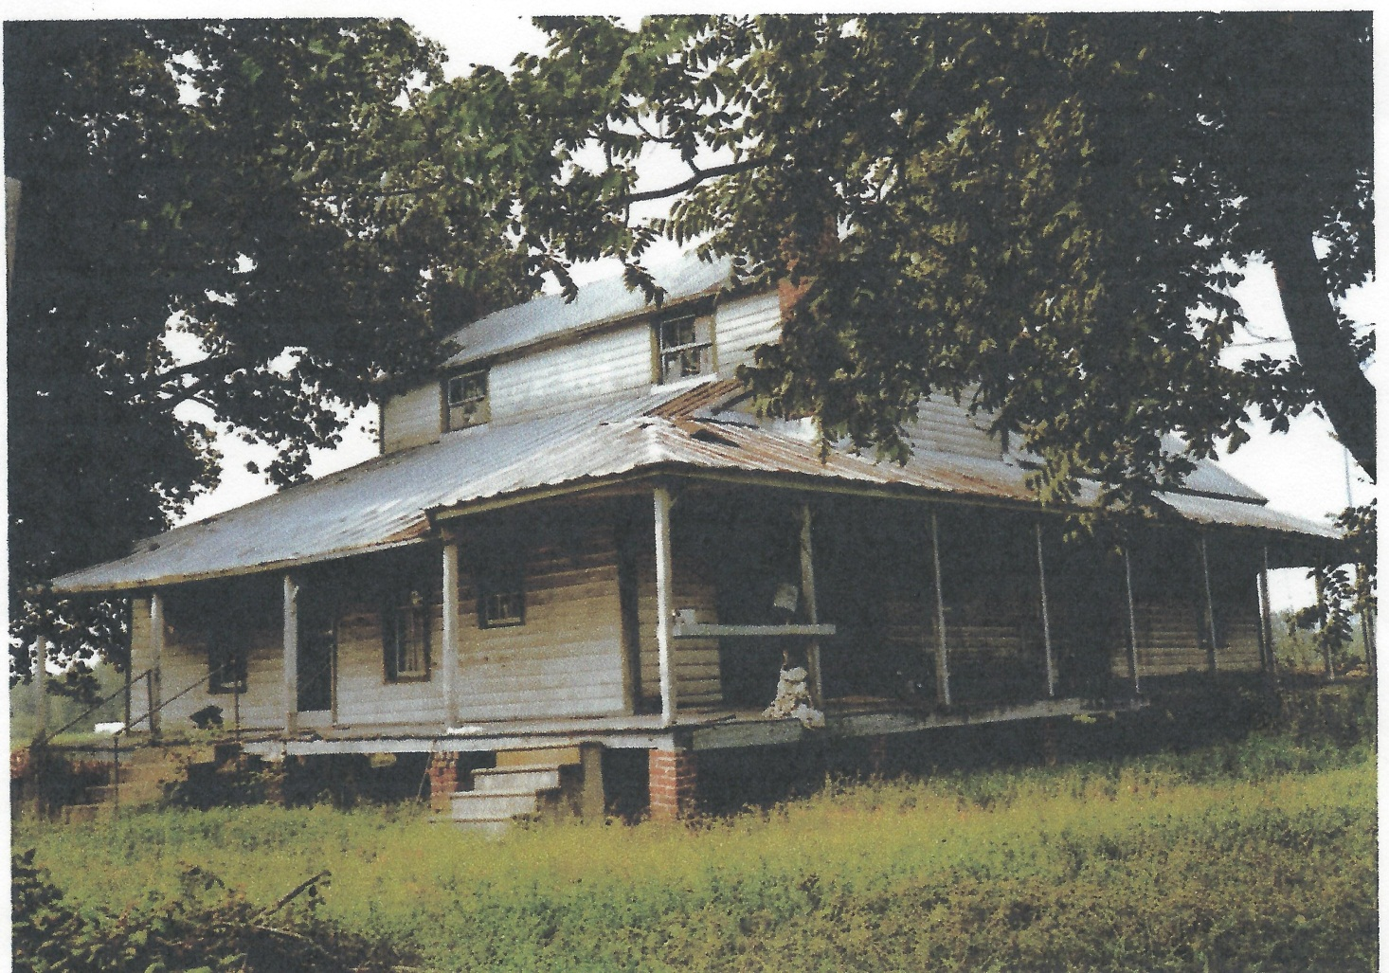
Rear View of Henry Bradford’s House
The most recent owners are the Charlie Denton family.
Notes:
John Denton sold the house to the Historic Halifax Restoration Association to be moved to Halifax and to be called the Bradford-Denton House.

Slide 36
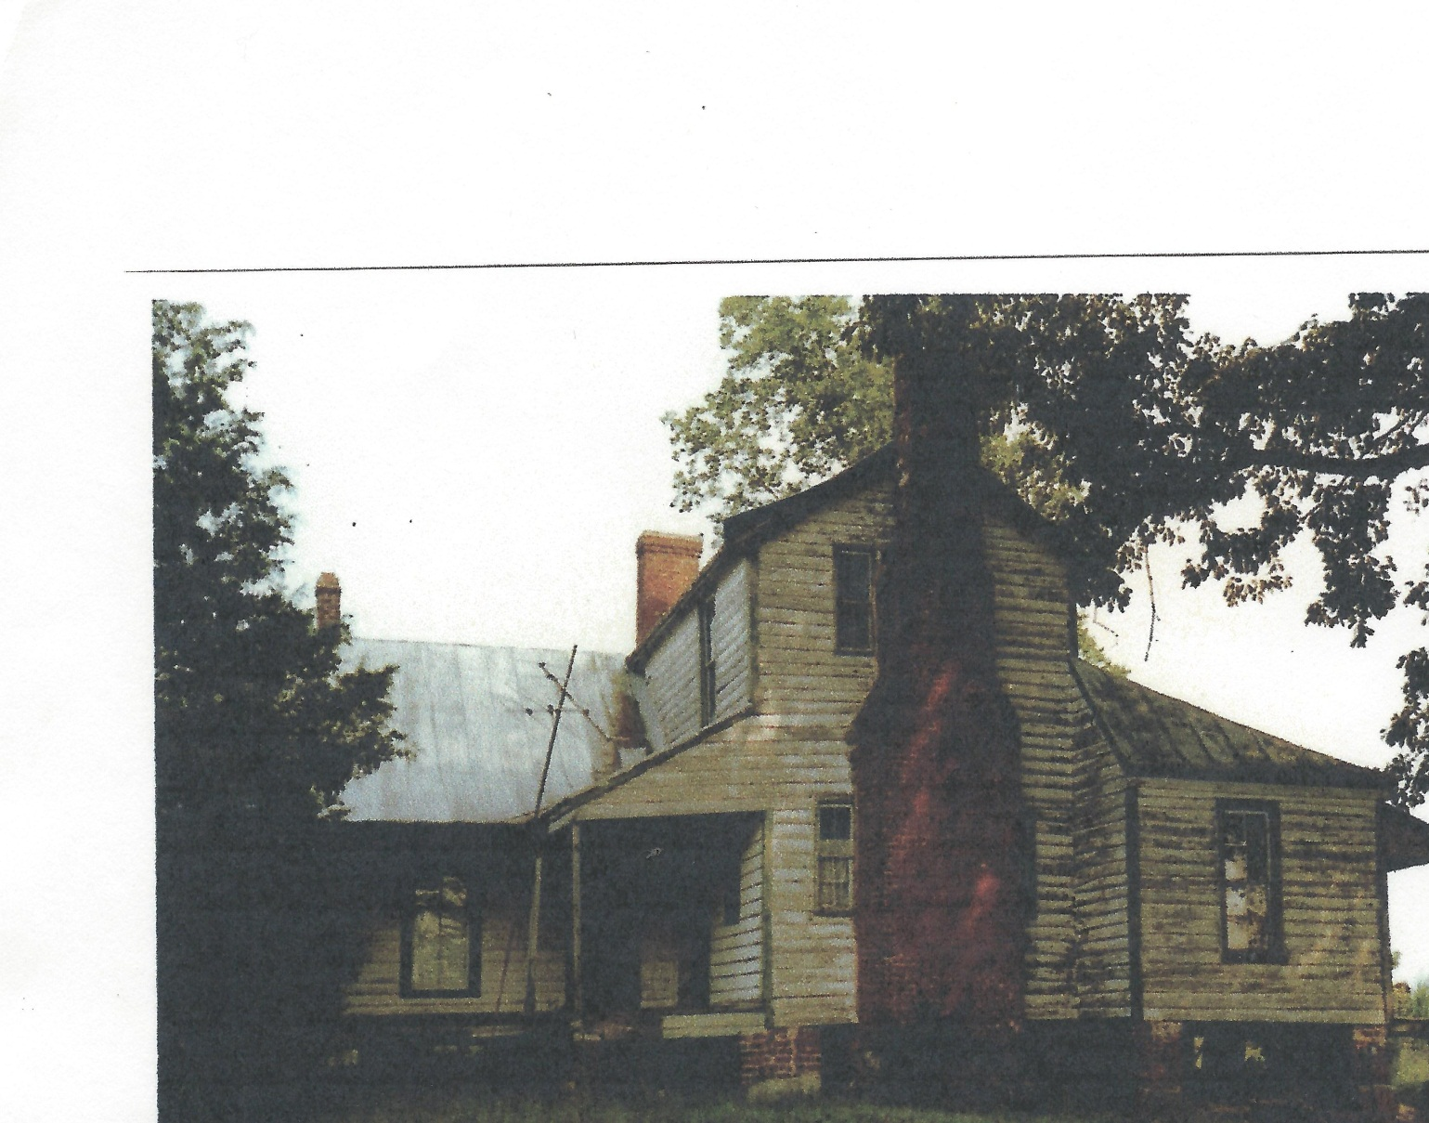
West Side of Henry Bradford’s House
This is the view from the camp meeting log huts.

Slide 37
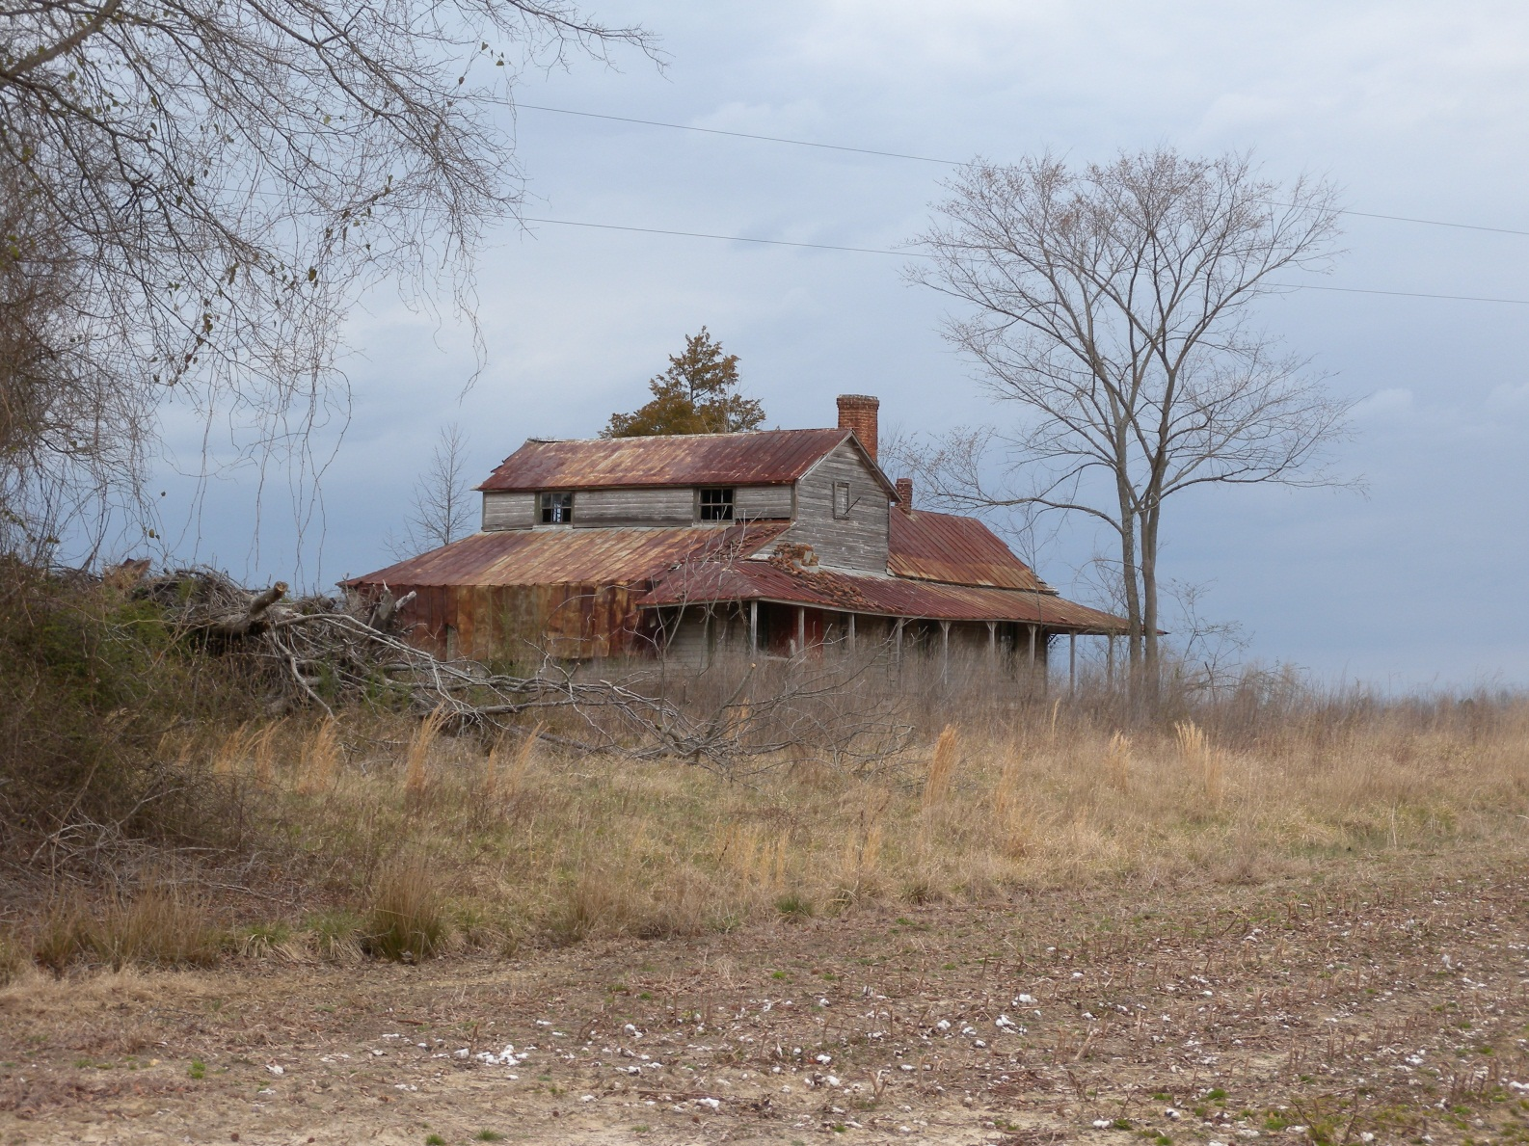
The Henry Bradford House
Before it was saved from destruction.

Slide 38
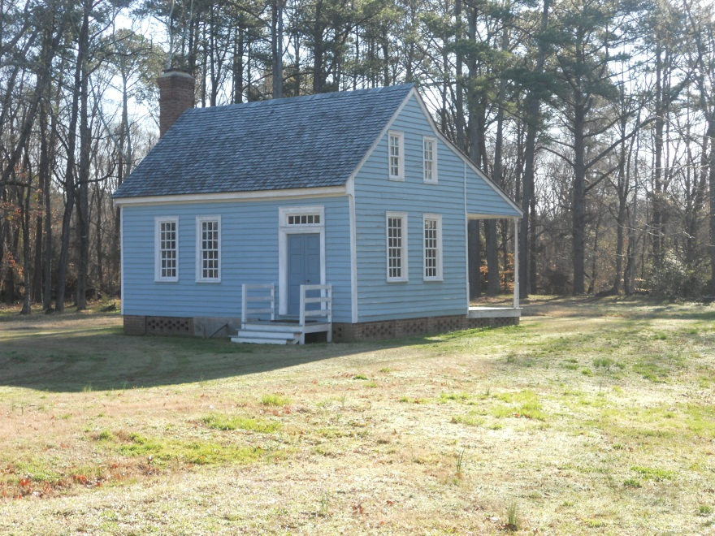
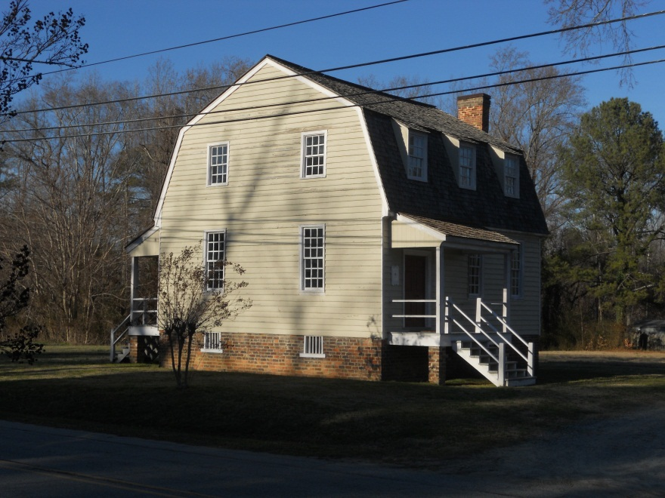
The Henry Bradford House was built as a story and a half like the Burgess House and was enlarged into a gambrel-roof house like the Owens House.
Burgess House
Owens House

Slide 39
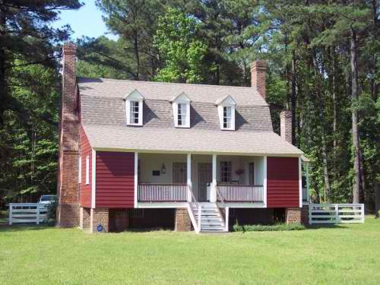
Old Town Plantation 1785 Edgecombe County , N.C.
The Henry Bradford house is similar to Old Town in design. It will have one shed room on the front, only two dormer windows, one end fireplace, and one corner fireplace.

Slide 40
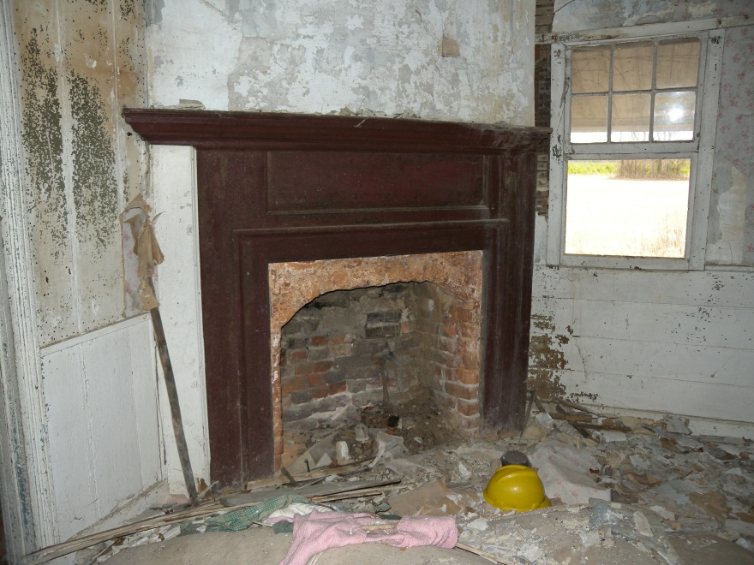
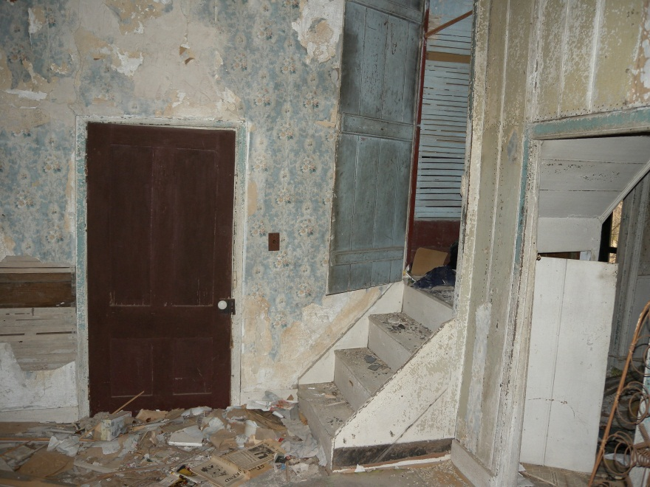
Interior of Henry & Sarah Bradford’s Home
155 years after Dr. Edward Bradford last visited his childhood home.
Corner fire place in front room.
Original mantle and brick work.
Front door with steps to the winder staircase.
These are the two rooms that Asbury said were filled when he preached in the home.

Slide 41
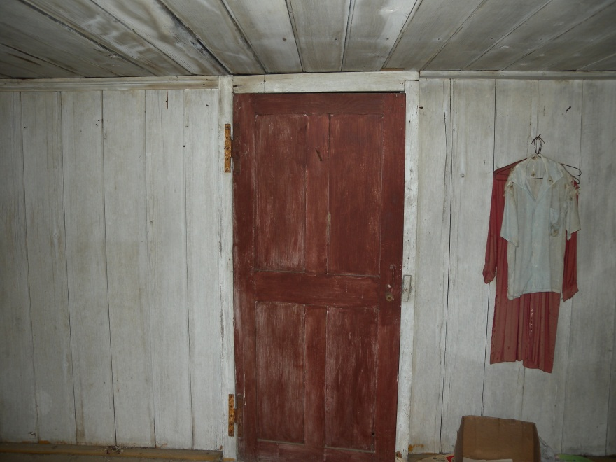
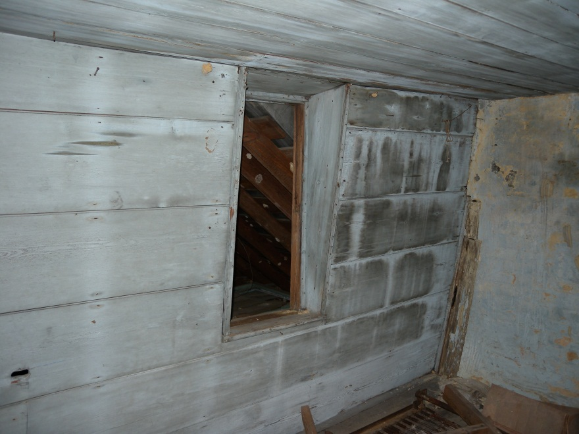
Bradford House upstairs.
Beaded board with all original handmade nails and hinges.
Center wall upstairs door with H hinges and early red oxide paint. Walls and ceiling covered with beaded boards 9-14 inches wide.
Top left room with corner chimney passing through it. Original dormer window that was protected from the elements by a later addition to the house.

Slide 42
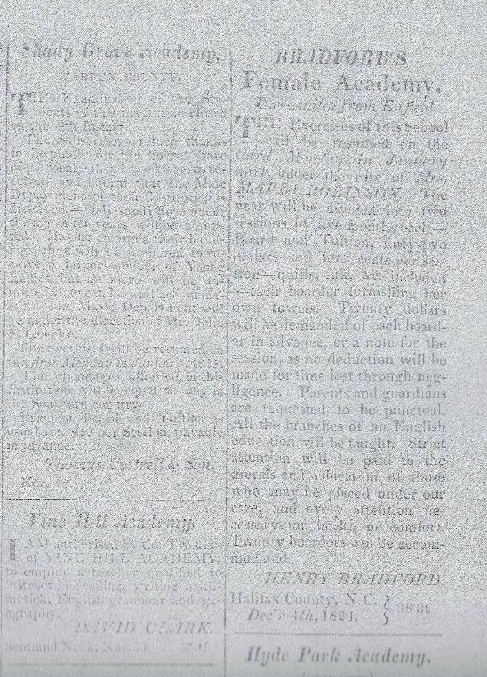
Bradford’s Female Academy
Under the care of Maria Robinson. Can accommodate twenty boarders.
Halifax Free Press December 1824

Slide 43
Maria Robinson was the widow of Captain James Robinson who was in command of a United States Man-of-War. Having met and fallen in love in England, James and Maria wed there prior to the War of 1812. When the war began, Maria was expecting a child, and James left on his ship to sail to the United States. After giving birth to their son, Maria and child set sail for America. Coming into Philadelphia harbor, Maria passed James on board his ship headed out to sea to war against her native England. As the ships sailed close enough for the couple to see each other, Maria held their child above her head for his father to see him for the first and, unknowingly, the only time. Captain James Robinson was killed in an engagement with the British Navy.

Slide 44
Maria made her way to Enfield, North Carolina, where she knew two sisters of her deceased husband lived. Finding them in as distressed a state as herself, she went about trying to earn a meager living for herself and her young son. Being the daughter of clergy, she had received an education in England that prepared her to be a much-sought-after teacher. Her teaching career started as instructor to the children of Governor John and Eliza Branch and continued as the teacher at Bradford’s Academy. Following the Bradford and Branch families to Florida, she also taught at Dr. Edward and Martha Bradford’s Pine Hill Plantation just north of Tallahassee.

Slide 45
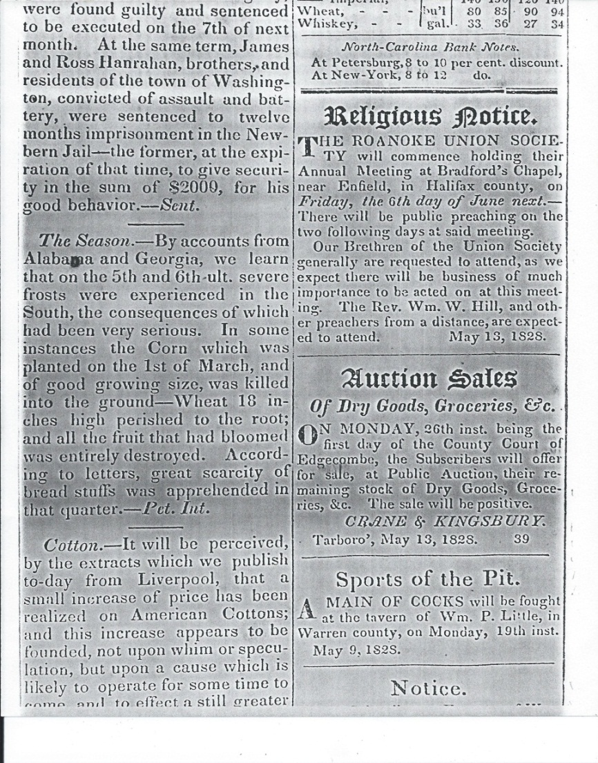
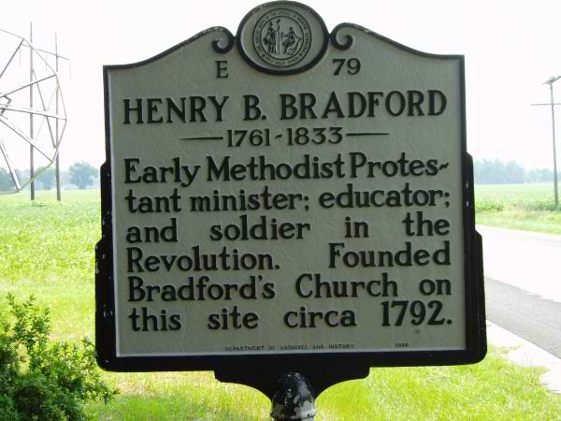
Bradford’s Chapel notice in the Tarborough Free Press, 1828. The chapel was located a short distance from Bradford’s House near the entrance of Shell Castle.

Slide 46
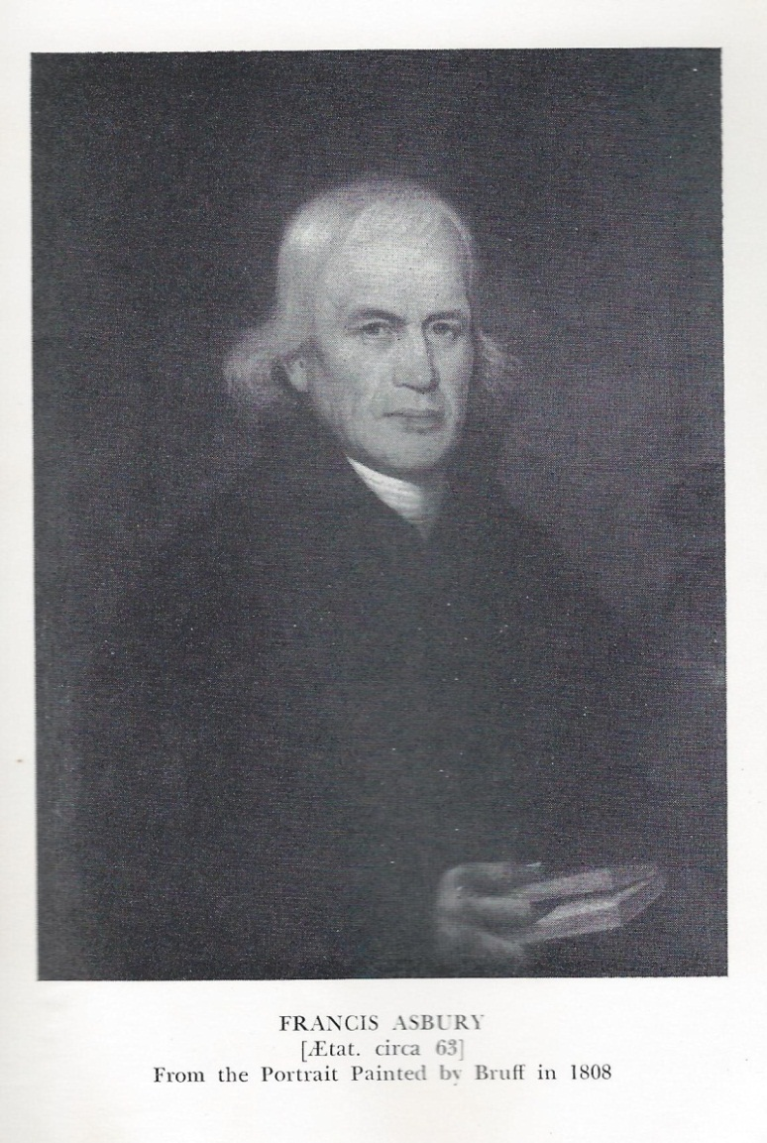
“The Prophet of the Long Road”
Bishop Francis Asbury traveled some 6000 miles annually. He came to America in 1771 and within the next fifty years traveled 270,000 miles and preached 16,425 sermons.

Slide 47
Bishop Francis Asbury and the Reverend Henry Bradford were fellow laborers in the Methodist Church as well as good friends. Bishop Asbury often visited in the Bradford home as he traveled through North Carolina. Certainly the friendship and ministry of Bishop Asbury was a great influence on the lives of the Bradford children. On one occasion Bishop Asbury wrote in his journal that he called for “dear Henry Bradford and wife” to join him at James Hunter’s.

Slide 48
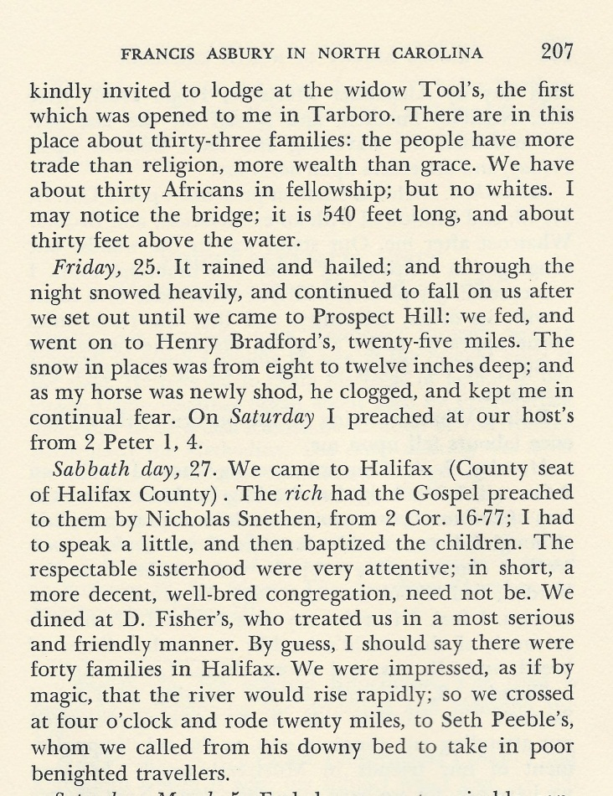
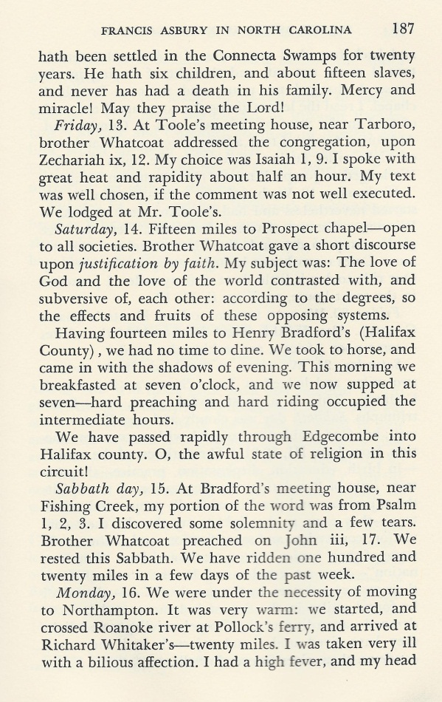
Bishop Francis Asbury’s Journal
February 25, 1803
March 15, 1801

Slide 49
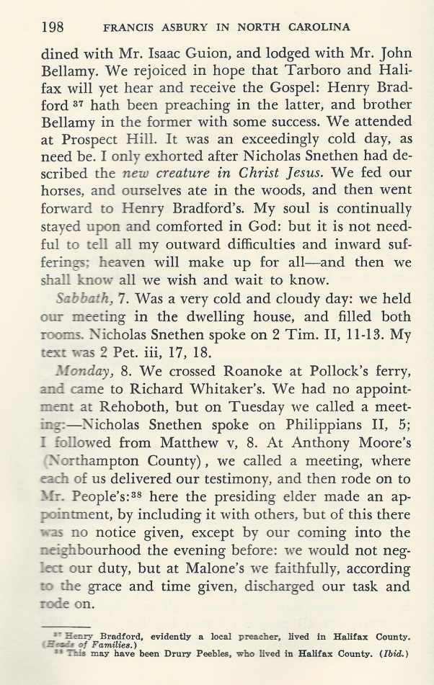
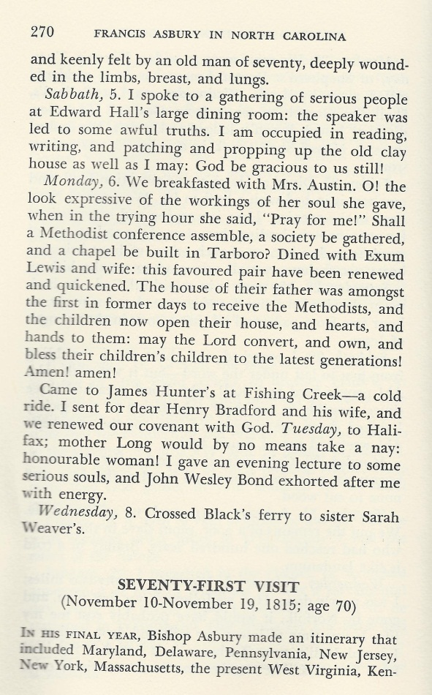
Asbury’s Journal Speaks of Henry Bradford
February 7, 1802
February 6, 1815

Slide 50
Henry Bradford organized and held Methodist camp meetings on his property in the early 1800’s. Log huts were constructed just west of his house. The huts were laid out in rows that would have resembled a small military encampment. This may have been from the knowledge Bradford had of camps from the Revolutionary War. From evidence in the ground today, it would seem that there was a common cooking area. In this camp early Methodists would assemble for extended periods of time for Christian worship and instruction in the Word of God. These camp meetings led to the construction of Bradford’s Chapel nearby.

Slide 51
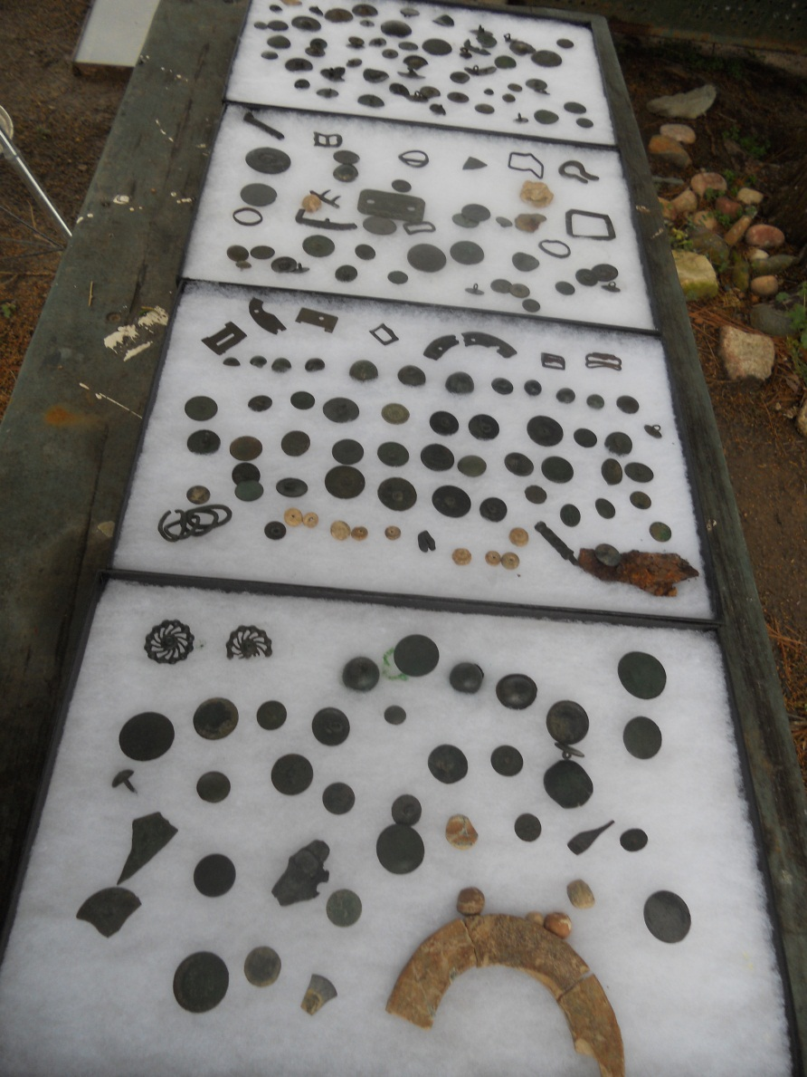
Bradford’s Camp meeting
Buttons and artifacts recovered from the open field to the west of the Rev. Henry Bradford’s house. Log huts were laid out in rows, forming a small village.

Slide 52
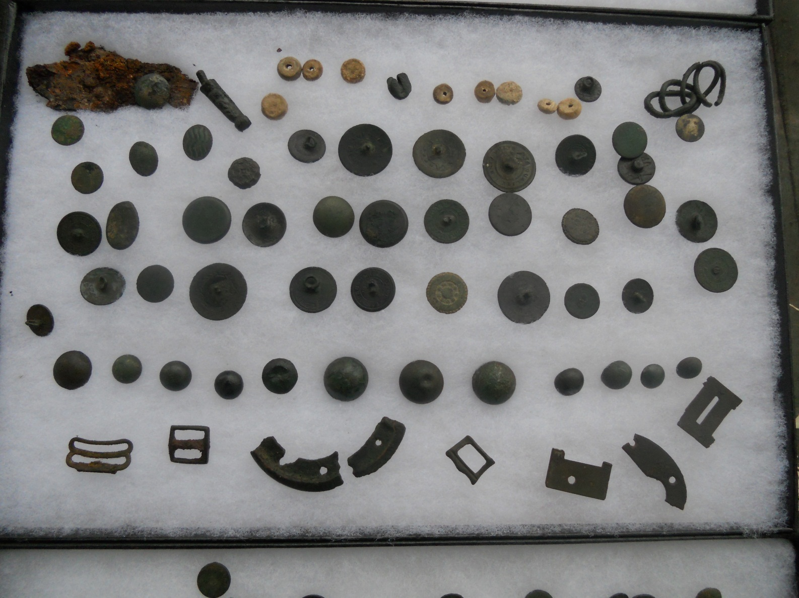
Bottom row of buttons is all ball buttons such as those worn on militia uniforms.

Slide 53


Brass perpetual rotating pocket calendar found under Bradford House. ca. 1832.
President George Washington’s 100th birthday.
Rotating disc with numbers of days of month. Days of the week written around the edge of the calendar.
Washington, the father of our country, on horseback with sword drawn. Born Feb. 22, 1732. Died Dec. 31, 1799.

Slide 54
Elk Marsh Plantation
Elk Marsh Plantation had been owned by the McCulloch family. During the War for Independence the McCullochs tended to favor the King of England in their politics. After the war much of their land was confiscated. Elk Marsh Plantation was held by the University of North Carolina and sold to Col. John Branch who moved his family out of Halifax to Elk Marsh seven miles away. Located on the property was the “Old Marsh Store,” meeting site of the early Masonic Lodge and a mustering site for State Militia during the war.

Slide 55

.
Elizabeth Norwood Branch in 1850 sought a pension on her husband’s military service.
James Green, a former sheriff of Halifax County stated that “he was frequently at the house of the Colonel John Branch and wife Elizabeth at a place called and known as the Marsh Store on Marsh Swamp.”
Col. Branch died at his residence in March of 1806.

Slide 56

First Actual Survey of North Carolina 1808
“Marsh Store,” site of Col. John Branch’s Elk Marsh Plantation
Susan Eppes wrote of her grandfather’s proudest day as the one when he found a child lost in the swamp.
Elk Marsh Swamp was in sight of Gov. Branch’s childhood home.

Slide 57


Royal White Hart Masonic Lodge
Grave of Joseph Montfort,
“The First-The Last-The Only
Grand Master of America”
The first Royal White Hart Lodge met at “Old Marsh Store.” Col. Bradford and Col. Branch were members of Royal White Hart Lodge.

Slide 58

Historical Marker for John Branch
Located Along Highway 301 in Enfield

Slide 59

Governor John Branch

Slide 60
John Branch 1782-1863
Graduated from UNC 1801
State Senate 1811-1817,1822
Speaker of N.C. Senate 1815-1817
North Carolina Governor 1817-1820
Federal Judge western Florida 1822
United States Senator 1823-1829
Secretary of the Navy 1829-1831
Congressman 1831-1833
Member of N.C. State Convention 1835
Governor of Florida 1844-1845

Slide 61

Halifax Free Press 1824
John Branch, Chief Justice Marshall, and John Randolph
arrive in Norfolk by steamboat.

Slide 62

The Marquis de Lafayette

Slide 63
The Marquis de Lafayette visited Halifax and Enfield on his tour of the United States in 1825. In Halifax he was met at the Roanoke River by four men who welcomed him to Halifax. One of these men was Joseph Branch, the brother of Governor John Branch. Escorting Lafayette to the Eagle Tavern, they traveled the street lined with men who were the members of the Masonic Lodge in Halifax. The ladies of the town welcomed him at the “Eagle,” and a reception was held that night. The next day Lafayette’s company traveled to the Grove where he had an emotional reunion with Mrs. Willie Jones. From Halifax they traveled ten miles south to Enfield where Lafayette made a brief stop at Joseph Branch’s home, “The Cellars.”

Slide 64

Eagle Tavern
Lafayette spent the night and was entertained in the Eagle Tavern during his visit to Halifax
in March of 1825.

Slide 65


Joseph Branch House “The Cellars,” built ca. 1820. Branch escorted Lafayette to his home to be refreshed on his journey toward Raleigh. Lafayette spoke to the assembled townspeople from the balcony.

Slide 66
It is probable that the Henry Bradford family was in attendance for the speech given by Lafayette from the balcony of The Cellars. Oral tradition says that young male students possibly from Enfield Academy marched and went through military drill for Lafayette using corn stalks for shouldering arms. The parents of future Confederate soldiers and leaders were in attendance at Lafayette’s visit to Enfield. The spirit of independence among the Branch and Bradford families extended from the War for Independence from English rule to the War for Southern Independence in 1861.

Slide 67


NC Free Press
Tarborough, NC 1833
March 23, 1833 Bradford Obituary
Hunter-Branch , July 16, 1833

Slide 68
Henry Bradford died at his home outside Enfield on March 23, 1833. Four of his sons had relocated to Florida where they were busy establishing cotton plantations north of Tallahassee in the area that would come to be known as Bradfordville. Sarah Crowell Bradford left her home in Enfield and traveled south to live with her son Richard Bradford. There she died in 1839 and was buried in her son’s (Dr. Edward Bradford )Pine Hill Plantation Cemetery.

Slide 69

Pine Hill Cemetery
Sarah Crowell Bradford was buried here in 1839.

Slide 70
The Wilmington and Weldon Rail Road was chartered as the Wilmington and Raleigh Rail Road. The route was changed from Raleigh to some point on the Roanoke River, and construction began in the port city of Wilmington, N.C. and in Halifax. Weldon was a short distance north of Halifax with a rail line already in existence from Weldon to Halifax. The charter allowed for a section of track to be opened if it were at least ten miles of new construction. The first section to be completed from Halifax ended in Enfield. Here stage coaches carried travelers south to the section of rail line extending north from Wilmington allowing rail travel to continue on to Wilmington where people traveling further south to Charleston, S.C. could board steamships.

Slide 71


Wilmington and Weldon Rail Road
Enfield
Gov. John Branch’s home was two blocks west on a slight rise.

Slide 72
When the Wilmington and Weldon Rail Road was opened to Enfield, it built a depot just 150 yards east of Gov. John Branch’s home. During the War for Southern Independence, trains loaded with wounded Confederate soldiers could be seen passing south through Enfield from his front porch. Gov. Branch’s home was described as sitting on a slight rise overlooking the Wilmington and Weldon depot. When completed in 1840, the Wilmington and Weldon Railroad was the longest railroad in the world.

Slide 73

Mr. Lawrence B. Whitaker Marianna, Florida
Wilmington and Raleigh Railroad Postmark

Slide 74

John Branch of North Carolina

Slide 75

Magnolia Trees Brought from Florida by Governor Branch
This scene is located to the right of Gov. Branch’s home near the path to the home of his daughter, Sarah Branch Hunter’s home.

Slide 76
Dr. Edward Bradford’s family traveled to Enfield in July 1857. Traveling on the Wilmington and Weldon Rail Road, they arrived to find Gov. Branch anxious about their safety after they had been delayed by swollen rivers and derailments. Susan Bradford Eppes wrote in her book Through Some Eventful Years that she visited many sites in Halifax County and the surrounding area with her grandpa. Jesse Bernard records in his journal of their visiting the Rev. Henry Bradford house. Martha Judge, the sister of the Bradford brothers, was living there.

Slide 77


The Master of
Pine Hill Plantation
Martha Lewis Branch Bradford
Dr. Edward Bradford

Slide 78

Susan Branch Bradford Eppes
Daughter of Dr. Edward Bradford and Martha Branch Bradford

Slide 79

View Toward the Springs Located on Branch’s Property
Viewed from the Location of the Early British Courthouse in Enfield ca. 1750

Slide 80


This coin was found near the springs on Governor Branch’s property . It had been in the ground over 100 years when Gov. Branch and his granddaughter rode on horse back to the springs in 1857.
Philippus V
1725 Hispaniarum Rex

Slide 81
During the Bradfords trip to Enfield they visited Weller’s Vineyard in Halifax County. Here Sidney Weller had cultivated the scuppernong grapes to perfection. He was making wine and selling grape vine cuttings throughout the South. His wine had won awards as far away as Paris, France. He also allowed visitors to come to the vineyard and pick grapes to eat. It was said that his grapes were too large for even a crow to carry away. After his death his family sold the vineyard to the Garrett brothers who enlarged the operation and changed the name to Medoc Vineyards. It was in operation until a fire destroyed it just prior to prohibition. Today, it is part of the Medoc Mountain State Park in Halifax County.

Slide 82

Weller’s Vineyard
Susan Bradford wrote of visiting the vineyard with her grandpa, Governor Branch,
during their visit to Enfield in July of 1857.

Slide 83
The Bradfords went to Shocco Springs with Gov. Branch in the summer of 1857. Susan Bradford wrote that there were 500 people there on account of a tournament being held there the following week. Nearby was the Jones White Sulphur Springs. Here during the War Mrs. Robert E. Lee and their daughters visited. It was at the Jones Hotel that General Lee’s daughter Annie Carter Lee died and was buried in the Jone’s family cemetery. General Lee and his daughter Margaret visited the grave of Annie Carter just months before General Lee’s death. He was touched by the attention that her grave had received by the local people who had also erected a monument there. He remarked that she should rest in such a nice spot. Her remains were moved to Lexington, Virginia, in the 1980’s.

Slide 84

Jones White Sulphur Springs in Warren County
This structure was in the Shocco Springs area where Susan Bradford wrote that her grandfather John Branch
carried the visiting Bradford family in 1857. Gen. Robert E. Lee’s wife and daughters stayed here during much of the war. Lee’s daughter Annie Carter Lee died here and was buried in the Jone’s family cemetery. Lee visited her grave just months before his death.

Slide 85

Whitaker Town

Slide 86

Whitaker’s Chapel
Methodist. Whitaker’s Academy and the original church structure
were located across the road.

Slide 87

Strawberry Hill
Whitaker home built 1798. Home of Simm and Cary Whitaker.
Mrs. Anne Boyd Whitaker Bulloch greeting Jeff Dickens.

Slide 88


Deed from Governor Branch to Henry Joyner for a lot in Enfield. It was prepared by Cary Whitaker . In 22 months Governor Branch would pass away and in 4 years Cary Whitaker would die from wounds suffered in the closing days of the War for Southern Independence.

Slide 89


Mass Meeting
Grand Ratification Meeting and Pole Raising
Breckinridge & Lane

Slide 90

The men from Enfield and Halifax County respond to the call to arms in defense of their state.

Slide 91
Governor John Branch had held many political offices during his life both at the state and federal level. His father had been a colonel in the North Carolina militia and fought the British in the Revolution. North Carolina refused to ratify the U.S. Constitution until the Bill of Rights had been written. And now realizing the encroachment of the federal government into the state’s right to govern itself, Governor John Branch placed his support with the Confederate States of America.

Slide 92

North Carolina War Between the States Flag
First flag ever adopted by the state.
May 20, 1775
Mecklenburg Resolves
May 20, 1861
North Carolina declares its independence for a second time.

Slide 93


The “Enfield Blues”
Co. I, 1st North Carolina Volunteers
The ladies of Enfield present a flag to the “Enfield Blues”
Mrs. Whitfield took her blue silk dress and an American flag to make the Enfield flag.

Slide 94

Johnny Beavans, Simm Whitaker, Billy Beavans, Cary Whitaker
Members of the “Enfield Blues” Co. F, 1st North Carolina Troops

Slide 95
The Enfield Blues had been formed in response to the John Brown raids in Virginia. The men of Enfield and the surrounding area drilled and prepared themselves in case there was trouble. When the governor of North Carolina called for troops, the Enfield Blues responded and was awarded the designation of Co. F, 1st North Carolina Troops. They were sent to Virginia where they participated in the first battle of the War, the Battle of Bethel Church .
Henry Lawson Wyatt from nearby Tarborough was the first Confederate casualty of the War when he was killed at Bethel Church.

Slide 96

Stone at the Grave of Cary Whitaker
Whitaker’s Chapel Cemetery

Slide 97
Governor John Branch’s brother Joseph Branch died and Gov. Branch assumed the responsibility of educating his brother’s children. Lawrence O’Bryan Branch had practiced law in Florida and edited a newspaper there before coming back to N.C. He had turned down the position of Secretary of the Treasury under President Buchanan. He was a president of the Raleigh and Gaston Rail Road. Had the War not occurred, it is thought that he would have been governor of North Carolina.

Slide 98


Lawrence O’Bryan Branch
Raleigh & Gaston RR Stock. Branch had been president of the Raleigh & Gaston Rail-Road Company.

Slide 99

General Lawrence O’Bryan Branch
Nephew of Governor John Branch
Killed in battle at Sharpsburg
Lawyer
Congressman
President of Raleigh and Gaston Rail Road
Quartermaster for N.C.
Brigadier General

Slide 100

Death of General Lawrence O’Bryan Branch
Memorial cannon at the spot General Branch died.
General Branch died at the Battle of Sharpsburg. As he stood in conference with Generals A. P. Hill, Maxcy Gregg, Dorsey Pender, and James Archer, a Union sharpshooter seeing the group fired and struck Branch killing him instantly. Governor Branch was deeply grieved by the death of his nephew.

Slide 101


Grave of General Lawrence O’Bryan Branch
Old City Cemetery, Raleigh, N.C.

Slide 102
John Branch never fully recovered from the death of his favorite nephew Lawrence O’Bryan Branch. He was directing the cutting of ice in December of 1862 when he became ill with pneumonia. He had stated that he wanted to be buried next to his beloved wife Elizabeth Fort Branch in Pine Hill Cemetery but because of the uncertainty of travel due to the War, he decided that it mattered not where his body resided in death and asked to be buried in Enfield. He was laid to rest in what may have been the old Col. John Bradford Cemetery located on Branch’s property.

Slide 103

Governor Branch’s Grave ca. 1871

Slide 104

Gov. John Branch’s Grave
Dr. James Hunter’s and Sarah Branch Hunter’s headstone is far left behind the tree.

Slide 105


Branch-Hunter Headstones

Slide 106

Gov. John Branch’s Grave
Overlooking “Enfield Old Courthouse” site with a view towards Gov. Branch’s home.

Slide 107

Bradford-Branch-Hunter Cemetery
This property and that across the field were the land of Col. John Bradford.
Bradford’s home would have been located nearby.

Slide 108
With the death of Governor John Branch, the Bradford-Branch story ends in Enfield and Halifax County. But recent efforts to protect and restore the Reverend Henry Bradford House have caused renewed interest in these important Halifax County families. It is hoped that through the restoration of the Reverend Henry Bradford House in Historic Halifax that the Bradford-Branch story might be shared for many more generations.

Slide 109

Through the Bradford House, the story continues………..

Slide 110
Presented to the Bradford-Branch Gathering
Saturday March 24, 2012 by Jeff E. Dickens of Halifax County, North Carolina
1996 Tanner Road
Littleton, North Carolina 27850 halifaxcotton@yahoo.com

Slide 111
Suggested reading:
Through Some Eventful Years,
Verses from Florida,
The Negro of the Old South, by Susan Bradford Eppes
John Branch by Marshall DeLancy Haywood
Rebel Boast by Manly Wade Wellman
The Journal of Jesse Bernard located in the Florida Archives

